Slide 1
Stablehand
Medium Work
A Stablehand is responsible for the care and management of horses. Working independently, they carry out duties such as stable cleaning, feeding, grooming, handling, and tacking, all conducted onsite within the stables.
Onsite: Stable hands complete work predominantly in the stables area. Stable hands work in a combination of both covered and uncovered environments with exposure to the outdoor elements.
Offsite: Stable hands offsite work completing these same duties at races or events, where locations can be varied. Exposure to cold and warm temperatures.
Stable hands standard working hours may vary. Predominantly shifts are split between the following timeframes
AM: 3.00am-9.00am
PM: 1.00pm-5.00pm
Split shift structure so no formal breaks scheduled
Enclosed shoes, gloves
Rake, broom, grooming combs, sponges, cloths, hose, lead, saddlery equipment , wheelbarrow, bins, trolleys, Bridle, water buckets,, and feed scoop.

Slide 3
Job Task | Frequency | Classification
General Stable Duties Removal of water buckets, feed bins and hay bags from the horse box, requiring bending, stooping, reaching, and sufficient grip strength to lift and transport items to the designated area. Taking horses temperature and administering medication to horses requires fine motor skills. Rugging and un-rugging horses requires bending, stooping, reaching, and fine motor skills, including overhead lifting of rugs weighing up to approximately 4 kilograms. Preparing Horses for Training (Tacking) Prepare equipment and select appropriate saddle, saddle pad, and girth for each horse. Place saddle pad and saddle correctly on horses back. Requires forward reaching, manual dexterity and lifting of 5 kilograms. Secure the girth to ensure comfort and safety. Requires fine motor skills and grip strength. Adjust straps and check bridle fit. Requires fine motor skills, pull down motion and grip strength. Prolonged standing required when saddling horse. Placing bridle on a horse involves forward and lateral reaching. Use of dexterity and grip strength to tighten bridle to fit industry standards. Occasional bending when moving around horse to check fit. Unsaddling Tie horse up securely requires fine motor skills and grip strength. Loosen and remove girth and saddle requires manual dexterity, fine motor skills and grip strength. Lift saddle and saddle pad off horses back requires lifting and carrying up to 5 kilograms. Use of cloth to wipe down and clean the horses back to remove sweat and dirt. Shoulder rotation, bending and forward and lateral reaching required. Clean tack equipment as required. | Frequent | Medium Work

Slide 4
Feeding Preparing type and quantity of feed. Use of fine motor and upper limb dexterity. Collect bags of feed and hay bales up to 30kilograms may be required, requiring carrying, lifting, forward reaching, bending and stooping. Where lifting restrictions exist, lighter weights or mechanical assistance may be accommodated. Visual skills including reading of feed requirements. Use of feed scoop to measure feed, involving flexion and extension of wrist. Most typically completed with dominant hand. Push and pull of trolley with buckets. Lifting individual feed buckets approx. 5 kilograms. | Frequent | Medium Work
Cleaning Stables Gathering appropriate materials including rake, water buckets, waste disposal bins , wheelbarrow/trolleys and brooms. Walking, lifting of 10 kilograms and grip strength required to collect equipment. Bending, forward and lateral reaching to rake manure in horse box . Push, pull and rotation of trunk required to rake manure and place into waste bin. Lifting and carrying manure to disposal bins. 2 kilograms lifting capacity required. Walking to carry waste disposal bin to front of stables. Individual waste bin may be up to 20 kilograms. Lifting waste disposal bins onto trolley to transport to commercial bin. Pushing trolley of waste to commercial bins. Pushing mobile load. Sweep stable floor. Rotation and extension of wrists, forearms and shoulders required to sweep. Use of dominant hand to lead sweeping motion. Rotation of trunk and prolonged standing required to sweep in forwards/ backwards direction. | Frequent | Heavy Work

Slide 5
Job Task | Frequency | Classification
Leading Horses & Use of Horse Walker Placing a lead on the horse requires fine motor skills, stooping, forward reaching, and extension of the dominant hand to secure the clip to the halter. Leading a horse requires sufficient grip strength and arm stability to control a horse that may exert moderate to strong force (e.g., pulling, resisting, or shifting unexpectedly). Use of the right hand and arm is typically required to maintain a secure grip on the lead rope approximately 15–30 cm below the halter attachment point. Full-body balance and coordination required to walk alongside the horse at a steady pace while managing spatial awareness in potentially dynamic environments. Use of fine motor and dexterity skills to tie horse up and secure for saddling. Guiding horse to horse walker requires walking and fine motor skills to safely hold onto lead. Force may be required to stop walker and lead horse into position Pushing tolerance of 15 kilograms may be required to start walker | Frequent | Light Work
Grooming and Washing Secure horse Repetitive hand movements, forward, overhead and lateral reaching, bending and stooping to wipe down, dry and brush horse Lead and walk with horse to washing area Use of hose to wash down horse, requiring bending, stooping, reaching, trunk rotation and repetitive shoulder flexion and extension. | Frequent | Light Work

Slide 6
No formal education or qualifications required | Grip strength
Lifting up to 30 kilograms may be required | Fine motor and dexterity skills
Carrying of general items including horse tack less than 10 kilograms required | Information processing, attention to detail and an ability to work independently
Requires frequent walking | Time management skills
Pushing/pulling of wheelbarrows, bins, trolleys and gates | Personal Protective Equipment (PPE) requirements include enclosed shoes, gloves
Standing and walking for prolonged periods | Ability to follow Work Health & Safety (WHS) procedures
Bending, reaching and trunk rotation | Ability to follow instructions, problem solve and multitask

Slide 7
Infrequent
Stable hand role requires little to no sitting demands.
Constant
Stable hands are required to be on their feet for sustained periods throughout shift. Stable hands are frequently dynamic standing while completing all typical work tasks and brief bouts of static standing.
Frequently
Stable hands are frequently required to ambulate around the workplace while completing all typical work tasks. Stable hands mare frequently walking collecting equipment , leading and exercising horses. Stable hands may be required to jog with a horse.
Frequent
Stable hands are frequently required to maintain sustained trunk flexion, forward reaching and lateral reaching to safely place bridles, saddles and grooming tasks.
Frequent
Stable hands are required to squat or crouch frequently to complete duties.
Infrequent
Stable hand's role requires little to no kneeling demands.
Frequent
Stable hands are required to frequently bend to move around horse, place bridle and saddle on as well as groom and clean out horse box.
Infrequent
Stable hand role requires little to no crawling.

Slide 8
Frequent
Stable hand are required to complete forward reaching in all typical work tasks including grooming, washing, exercising and cleaning out of horse boxes. Stable hands frequently applying a medium degree of pushing and pulling force with forward reaching postures.
Frequent
At times Stable hand are required to complete overhead reaching tasks when placing bridles or saddles on horse as well as grooming and washing horse.
Frequent
Stable hands are required to complete lateral reaching movements. Stable hands use a range of equipment when completing cleaning, grooming and exercising tasks. They are required to reach laterally when picking up equipment.
Infrequent
Stable hands have little to no stooping requirements.
Constant
Stable hands are required to use fine motor coordination and dexterity when using equipment including rakes, grooming brushes and manipulating leads or buckles.
Frequent
Stable hands are required to exert high degrees of grip strength when completing saddling and unsaddling tasks, as well as raking or sweeping of boxes.
Frequent
Stable hands are required to twist and complete trunk rotation tasks when handling horses while exerting force when completing raking, sweeping and exercising tasks.
Infrequent
Stable hands are not required to drive.

Slide 9
Frequent
Up to 10kg
Stable hands are frequently required to lift below waist when lifting water buckets, tack and feed buckets
Infrequent
Up to 15kg
Stable hands are occasionally required to lift between waist to shoulder height when lifting tacking equipment, waste disposal bins and feed.
Frequent
5kg
Stable hands are not required to completing lifting demands between shoulder to overhead frequently. At times they are required to lift light items including bridle and saddles above shoulder height to place on horse in preparation for riders.
Frequent
Up to 25kg
Stable hands are required to complete pushing takes when completing exercise tasks such as placing horse on walker and when transporting feed or waste disposal bins.
Frequent
Up to 25kg
Stable hands are frequently required to complete pulling of up to 25 kilograms when feeding, exercising horses and transporting feed bins or waste bins
Frequent
Up to 10kg
Stable hands are frequently required to carry feed, tacking and cleaning equipment weighted up to 10 kilograms.

Slide 10
Constant
Stable hands are required to have strong eyesight to conduct their everyday duties, use equipment and detect potential risks or hazards in the workplace.
Constant
Stable hands are required to have strong hearing and listening skills to ensure they are aware of the potential risks and hazards, following instructions and communicating with other staff when required.
Frequent
Stable hand are required to have basic reading and writing skills to understand work sheets and written instruction.
Constant
Stable hands are required to demonstrate attention to detail and concentration when completing everyday tasks including grooming, washing, exercising and cleaning of boxes.
Constant
Required constantly
Constant
Required to demonstrate problem solving skills when interacting with horses and identifying potential risks or hazards in workplace.
Frequent
Stable hands are required to multi-task during their day and decipher priority job tasks to ensure effective time management.
Frequent
Stable hands are frequently required to be autonomous and work interpedently at the direction of a supervisor.
Frequent
Stable hands are required to have high accuracy and attention to detail when working with horses and equipment. They need to demonstrate intricate work skills when tightening bridles, saddles and manipulating equipment.
Notes:
VISUAL DEMANDS
Visual Acuity
Reading fine print or digital screens
Detecting subtle differences or changes
Recognizing objects and details at varying distances
Color Discrimination
Differentiating between colors and shades
Identifying color-coded information
Performing tasks that require accurate color perception
Visual Coordination
Coordinating hand-eye movements
Tracking moving objects
Performing tasks requiring precise visual alignment
Light Sensitivity
Adapting to different lighting conditions
Working under bright or dim lighting
Managing glare or reflections
---------------------------------------------------------------------
AUDIOMETRY DEMANDS
Hearing Acuity
Understanding spoken communication
Detecting alarms, signals, or machinery sounds
Discriminating between different sounds or tones
Listening Skills
Following verbal instructions
Engaging in conversations in noisy environments
Detecting subtle changes in sound for quality control
Sound Localization
Identifying the direction of sounds
Responding to spatial audio cues
Working in environments with complex soundscapes
---------------------------------------------------------------------
ATTENTION AND CONCENTRATION
Sustained Attention
Maintaining focus on a task over a long period
Avoiding distractions
Staying alert during repetitive tasks
Selective Attention
Focusing on relevant information while ignoring irrelevant information
Filtering out background noise
Prioritizing critical tasks
Divided Attention
Managing multiple tasks simultaneously
Switching attention between tasks
Balancing competing demands
---------------------------------------------------------------------
MEMORY
Short-term Memory
Retaining information for immediate use
Recalling instructions or details
Remembering short lists or sequences
Long-term Memory
Storing and retrieving information over extended periods
Recalling procedures and protocols
Retaining knowledge of systems and processes
Working Memory
Holding and manipulating information temporarily
Performing mental calculations
Integrating new information with existing knowledge
---------------------------------------------------------------------
PROBLEM SOLVING
Analytical Thinking
Breaking down complex problems into manageable parts
Identifying patterns and relationships
Evaluating data and evidence
Critical Thinking
Assessing the validity of arguments and claims
Making informed judgments
Identifying biases and assumptions
Decision-Making
Weighing options and consequences
Making timely decisions
Balancing risks and benefits
---------------------------------------------------------------------
LEARNING AND ADAPTATION
Learning Ability
Acquiring new skills and knowledge
Adapting to new methods and technologies
Implementing training and development
Flexibility
Adapting to changing demands and conditions
Modifying approaches based on feedback
Embracing innovation and change
Knowledge Application
Applying theoretical knowledge to practical situations
Integrating new information into existing frameworks
Updating skills and knowledge continuously
---------------------------------------------------------------------
JUDGEMENT AND REASONING
Logical Reasoning
Drawing logical conclusions from available information
Applying principles of logic to problem-solving
Recognizing logical fallacies
Abstract Thinking
Understanding complex concepts and ideas
Thinking creatively and innovatively
Grasping the big picture while focusing on details
Pattern Recognition
Identifying trends and patterns in data
Making predictions based on observed patterns
Detecting anomalies or irregularities
---------------------------------------------------------------------
INFORMATION PROCESSING
Speed of Processing
Quickly understanding and responding to information
Keeping up with fast-paced environments
Managing time-sensitive tasks
Accuracy of Processing
Ensuring precision in handling information
Avoiding errors and mistakes
Maintaining attention to detail
Complexity Handling
Managing and processing complex information
Dealing with ambiguity and uncertainty
Synthesizing information from multiple sources
---------------------------------------------------------------------
INTERPERSONAL COGNITIVE SKILLS
Social Cognition
Understanding and interpreting social cues
Recognizing emotions in others
Navigating social interactions and relationships
Empathy and Perspective-Taking
Understanding others' viewpoints
Demonstrating empathy in communication
Managing interpersonal conflicts

Slide 11
Constant
Stable hands are exposed to dust constantly in stables and exercise areas onsite
Infrequent
Stable hands are not exposed to gases
Infrequent
Stable hands are not exposed to fumes
Frequent
Stable hands are exposed to liquids including medicated washes, water buckets and horse medications
Frequent
Stable hands work in cold and hot weather
Frequent
Stable hands work within horse boxes and stables to complete everyday tasks
Frequent
At times stable hands are requires to walk and lead horse across slippery or uneven ground.
Constant
Stable hands are exposed to horse constantly onsite, where a large risk of injury is present
Frequent
Stable hands are exposed to substances including medicated washes, horse feed and medication.
Frequent
Stable hands are occasionally exposed to dangerous goods by way of horse medications and cleaning chemicals
Constant
Stable hands are required to interact and care for animals which poses high risk of injury and challenges within the work environment.

Slide 12
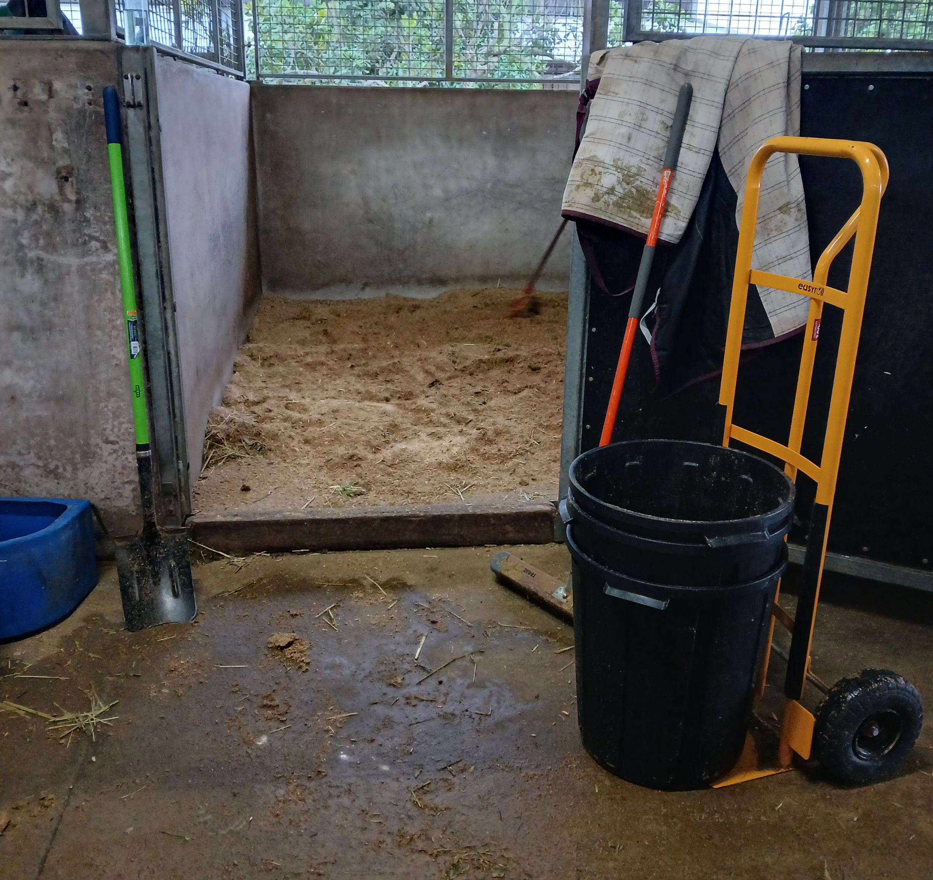
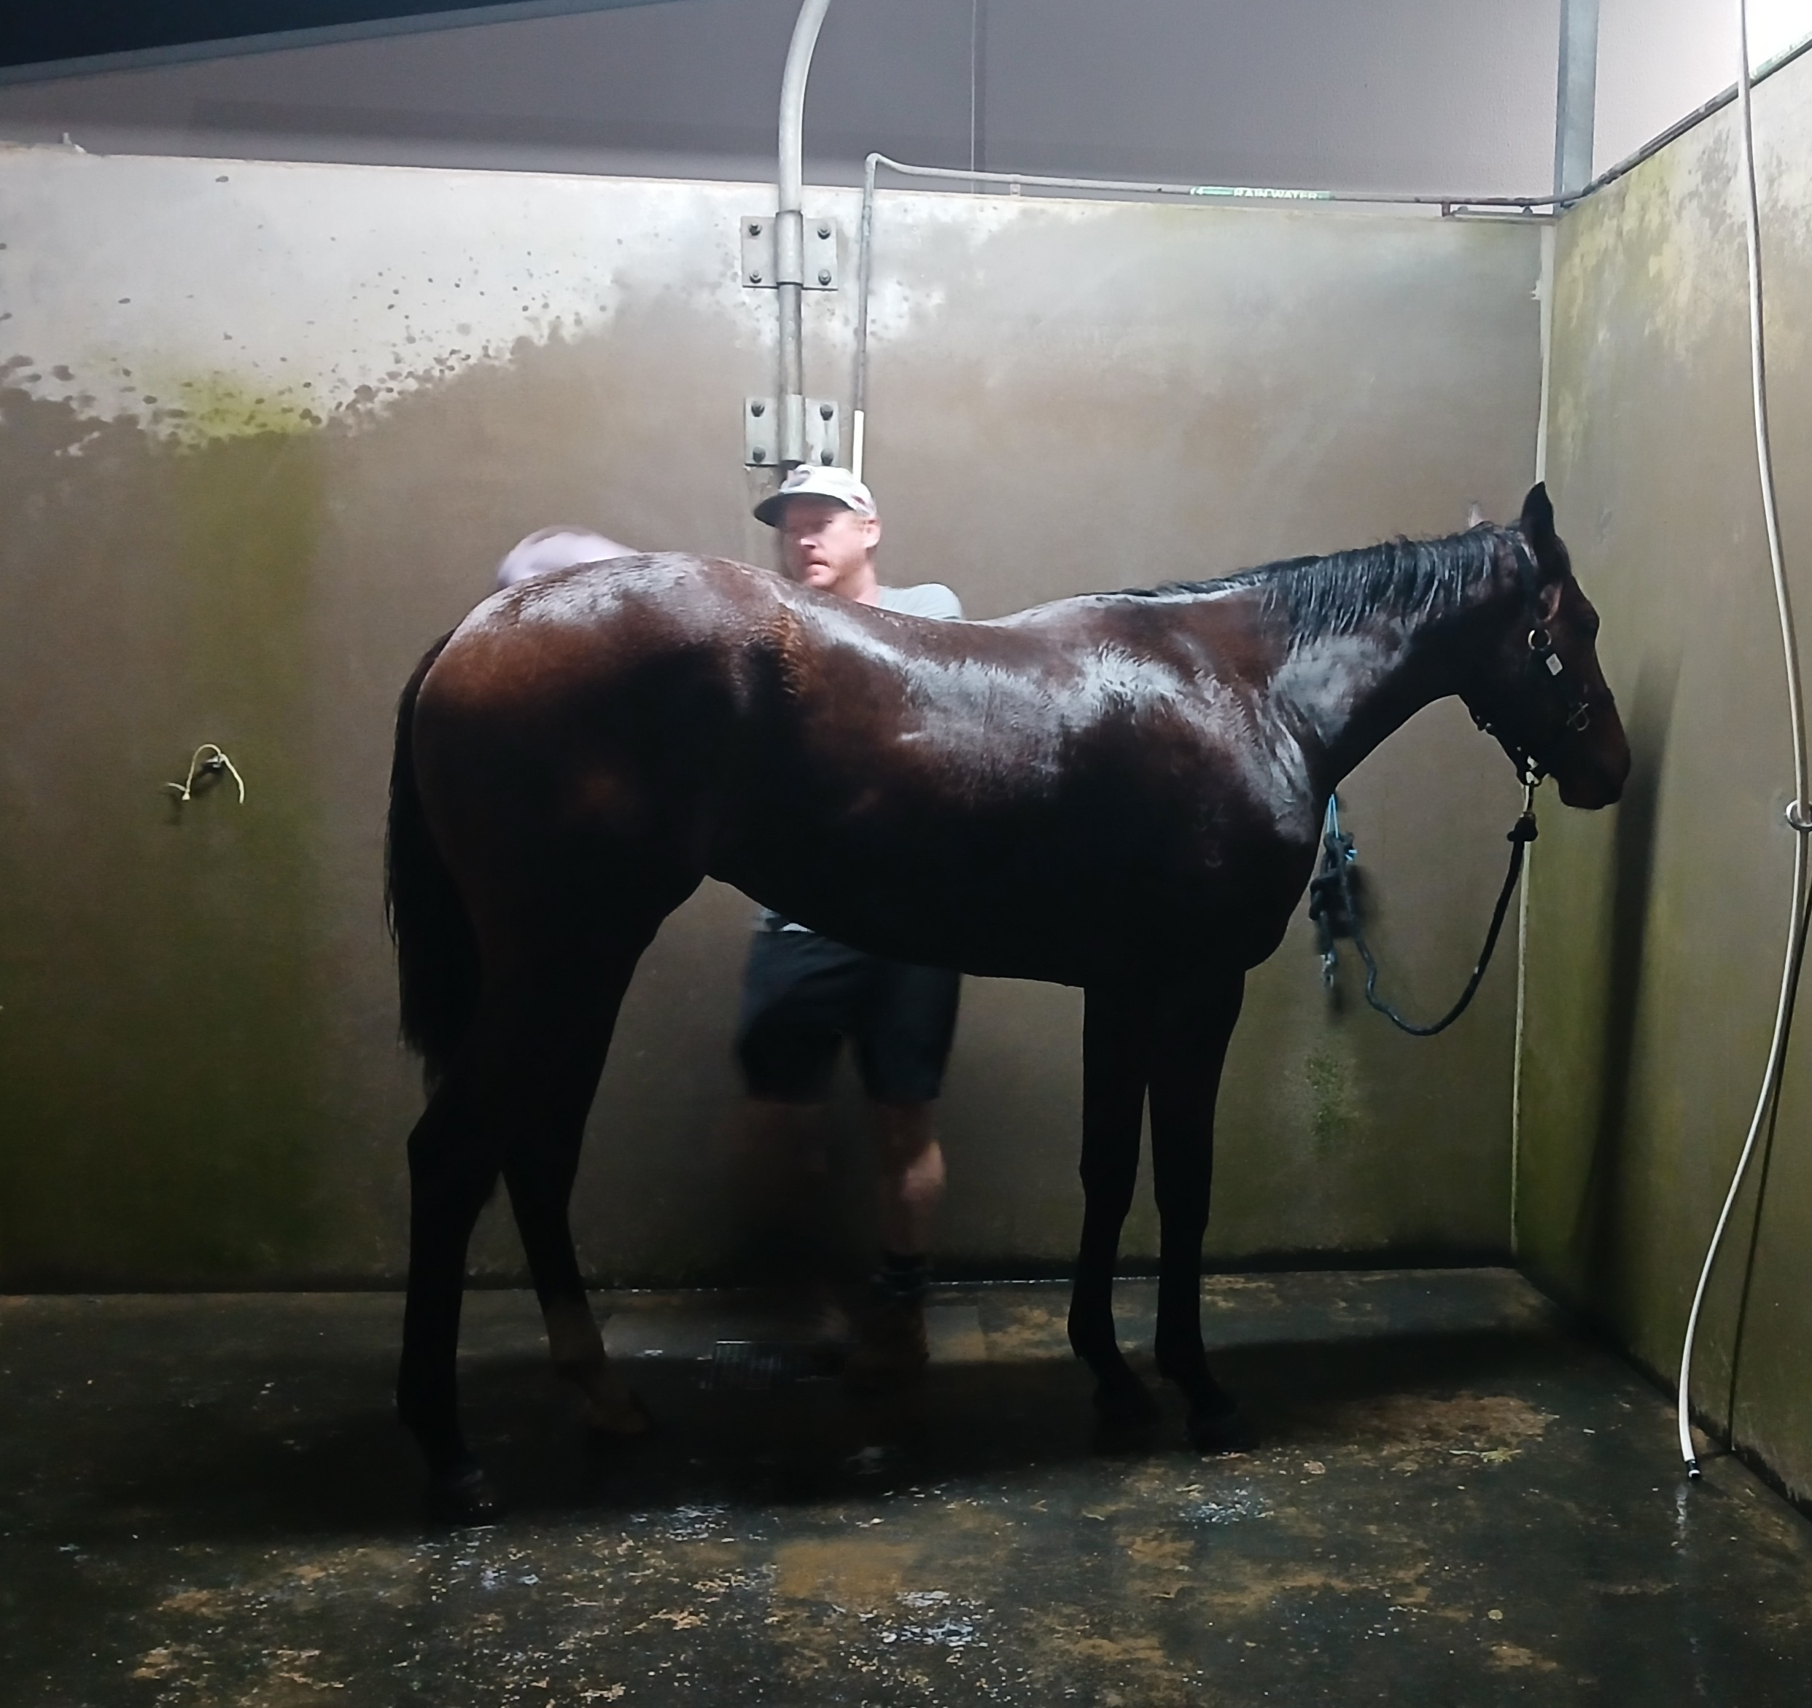
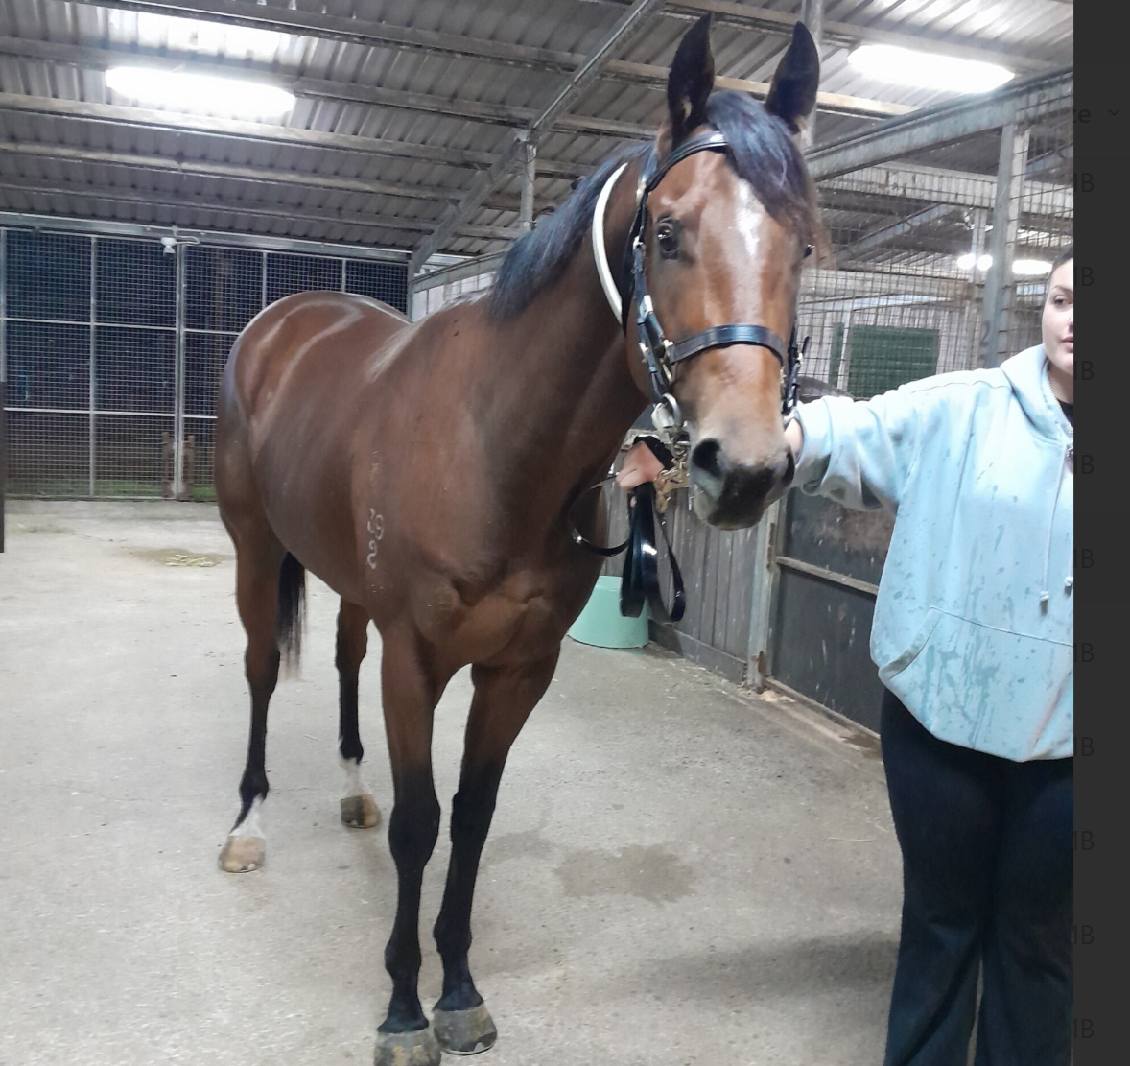
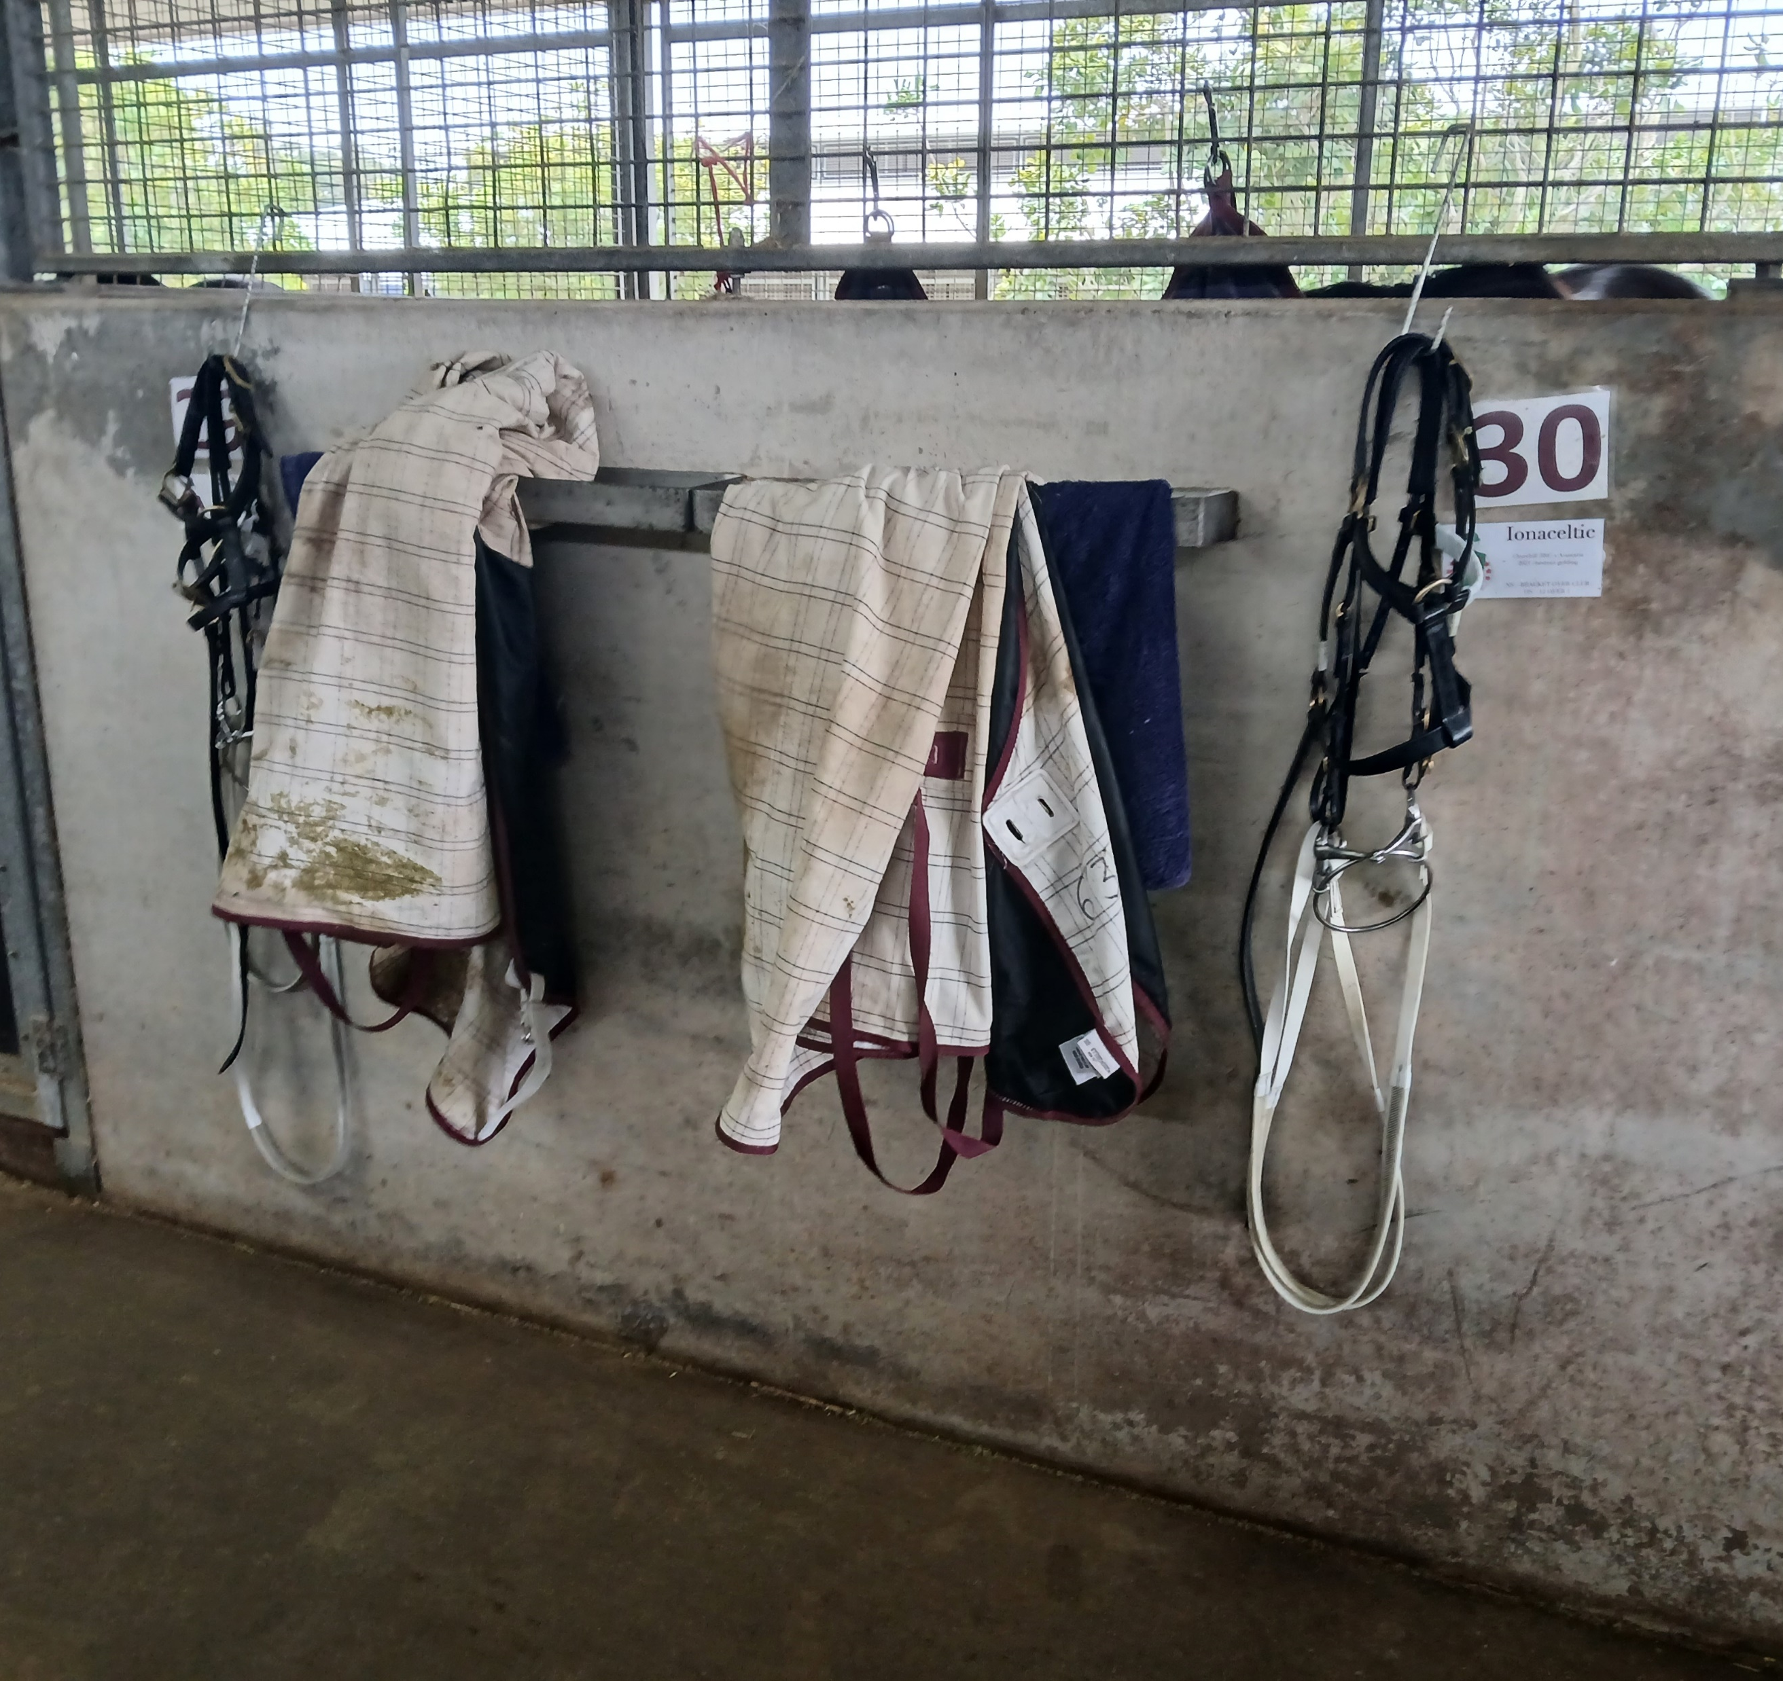
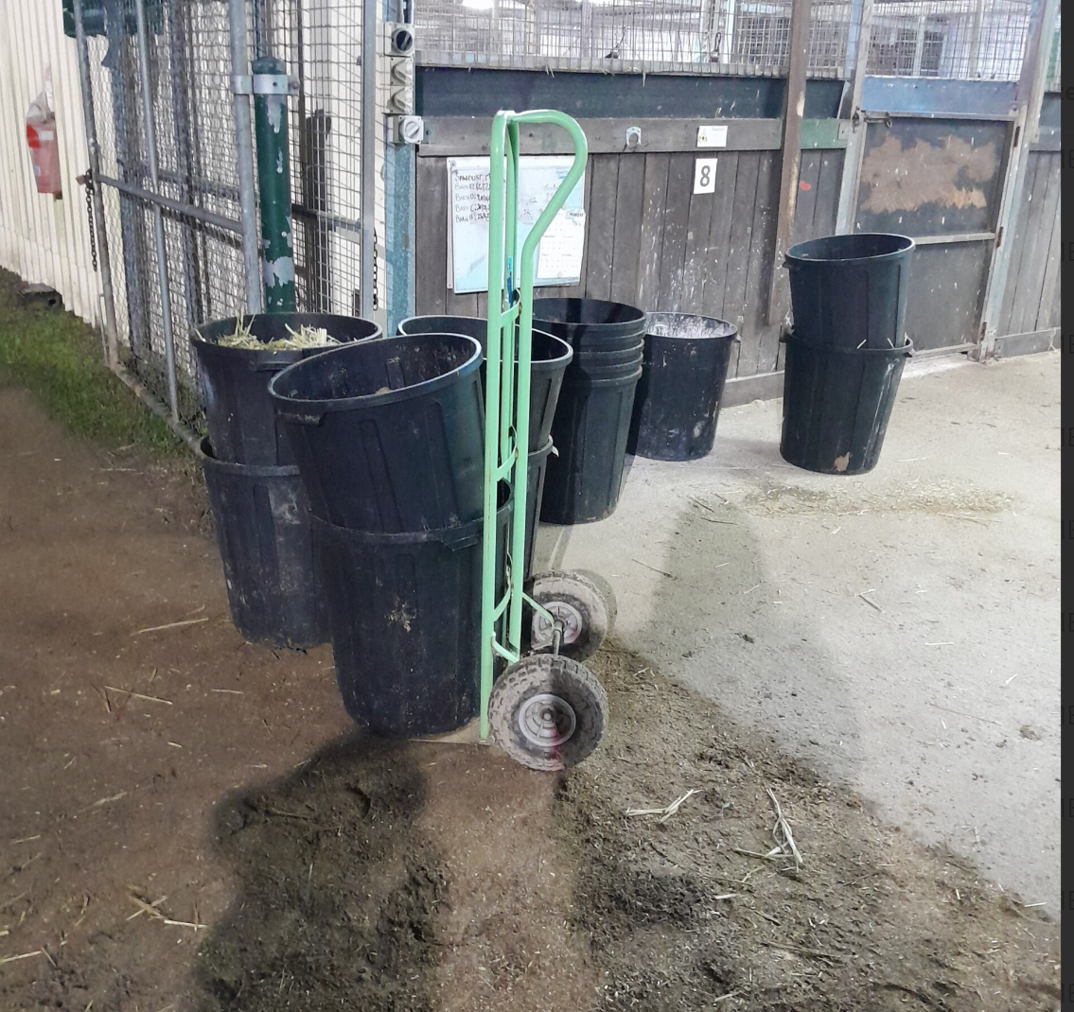
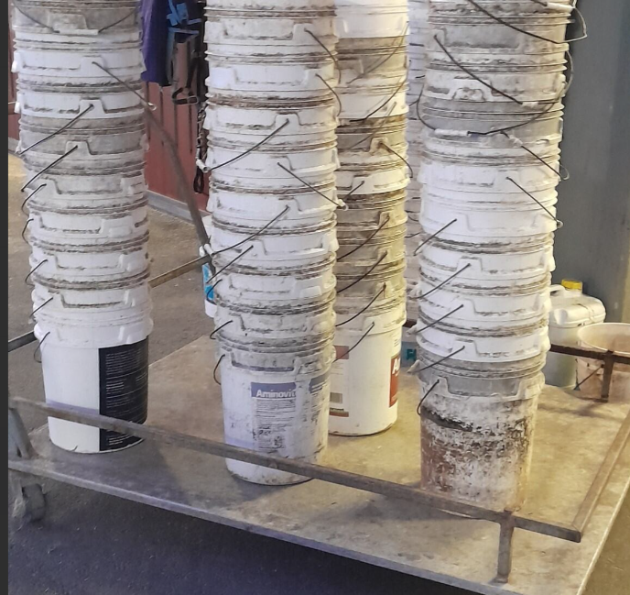
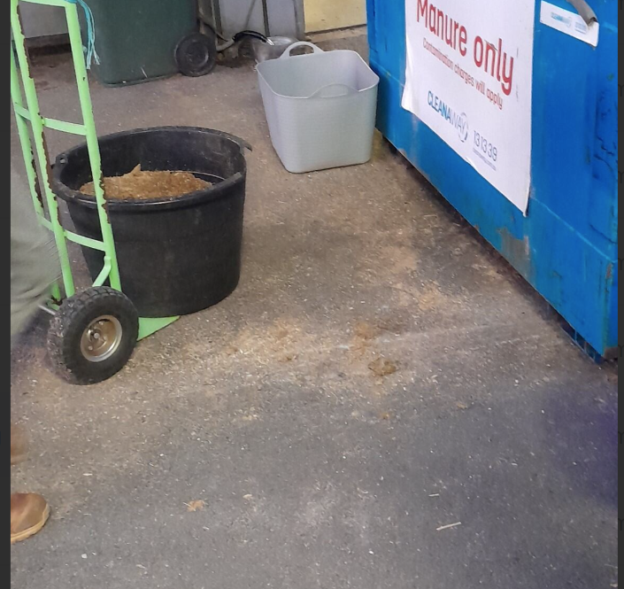
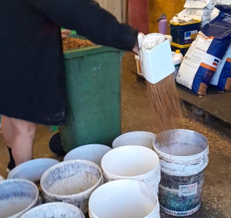
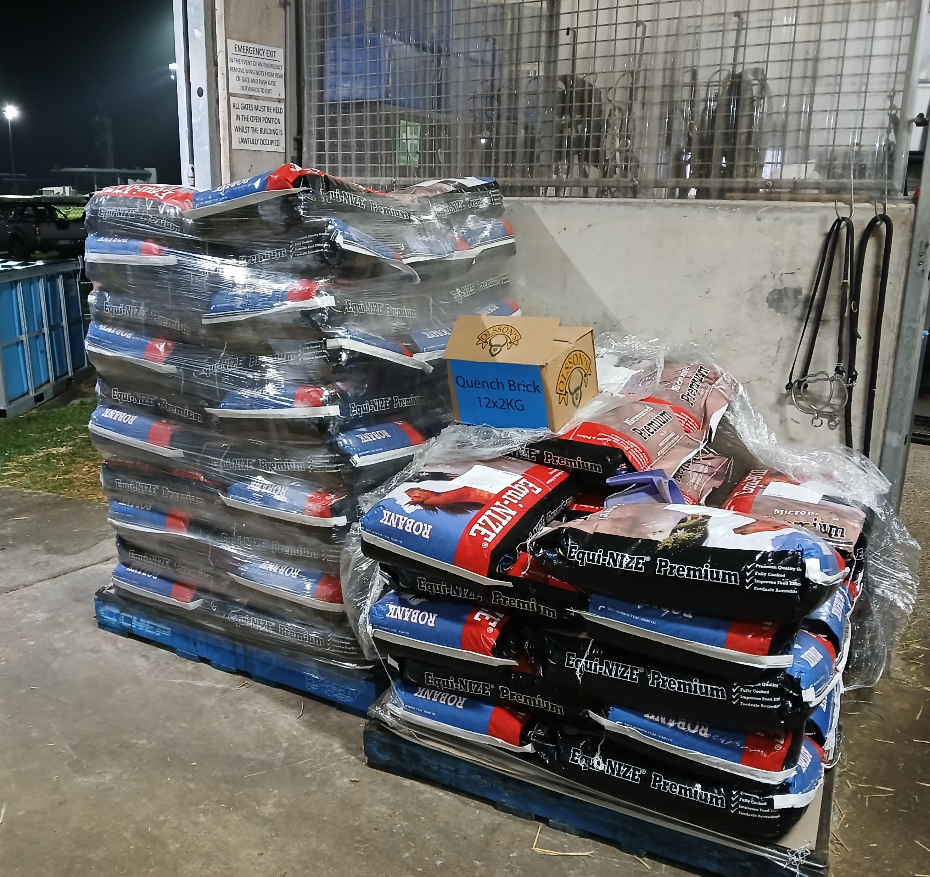
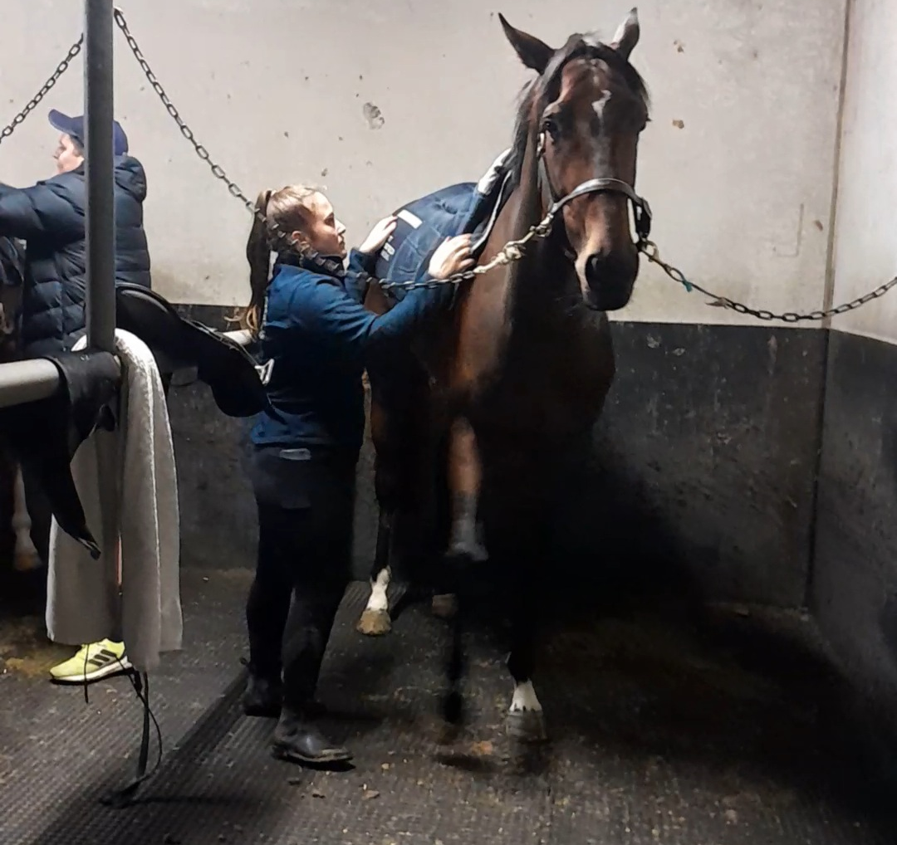
Stable hand equipment
Washing horse
Guiding horse, positioning of Tack
Equipment and Tack
Waste Disposal process
Feed buckets
Waste disposal process
Pouring and preparing feed
Image of food bags
Saddle pad placement

Slide 13
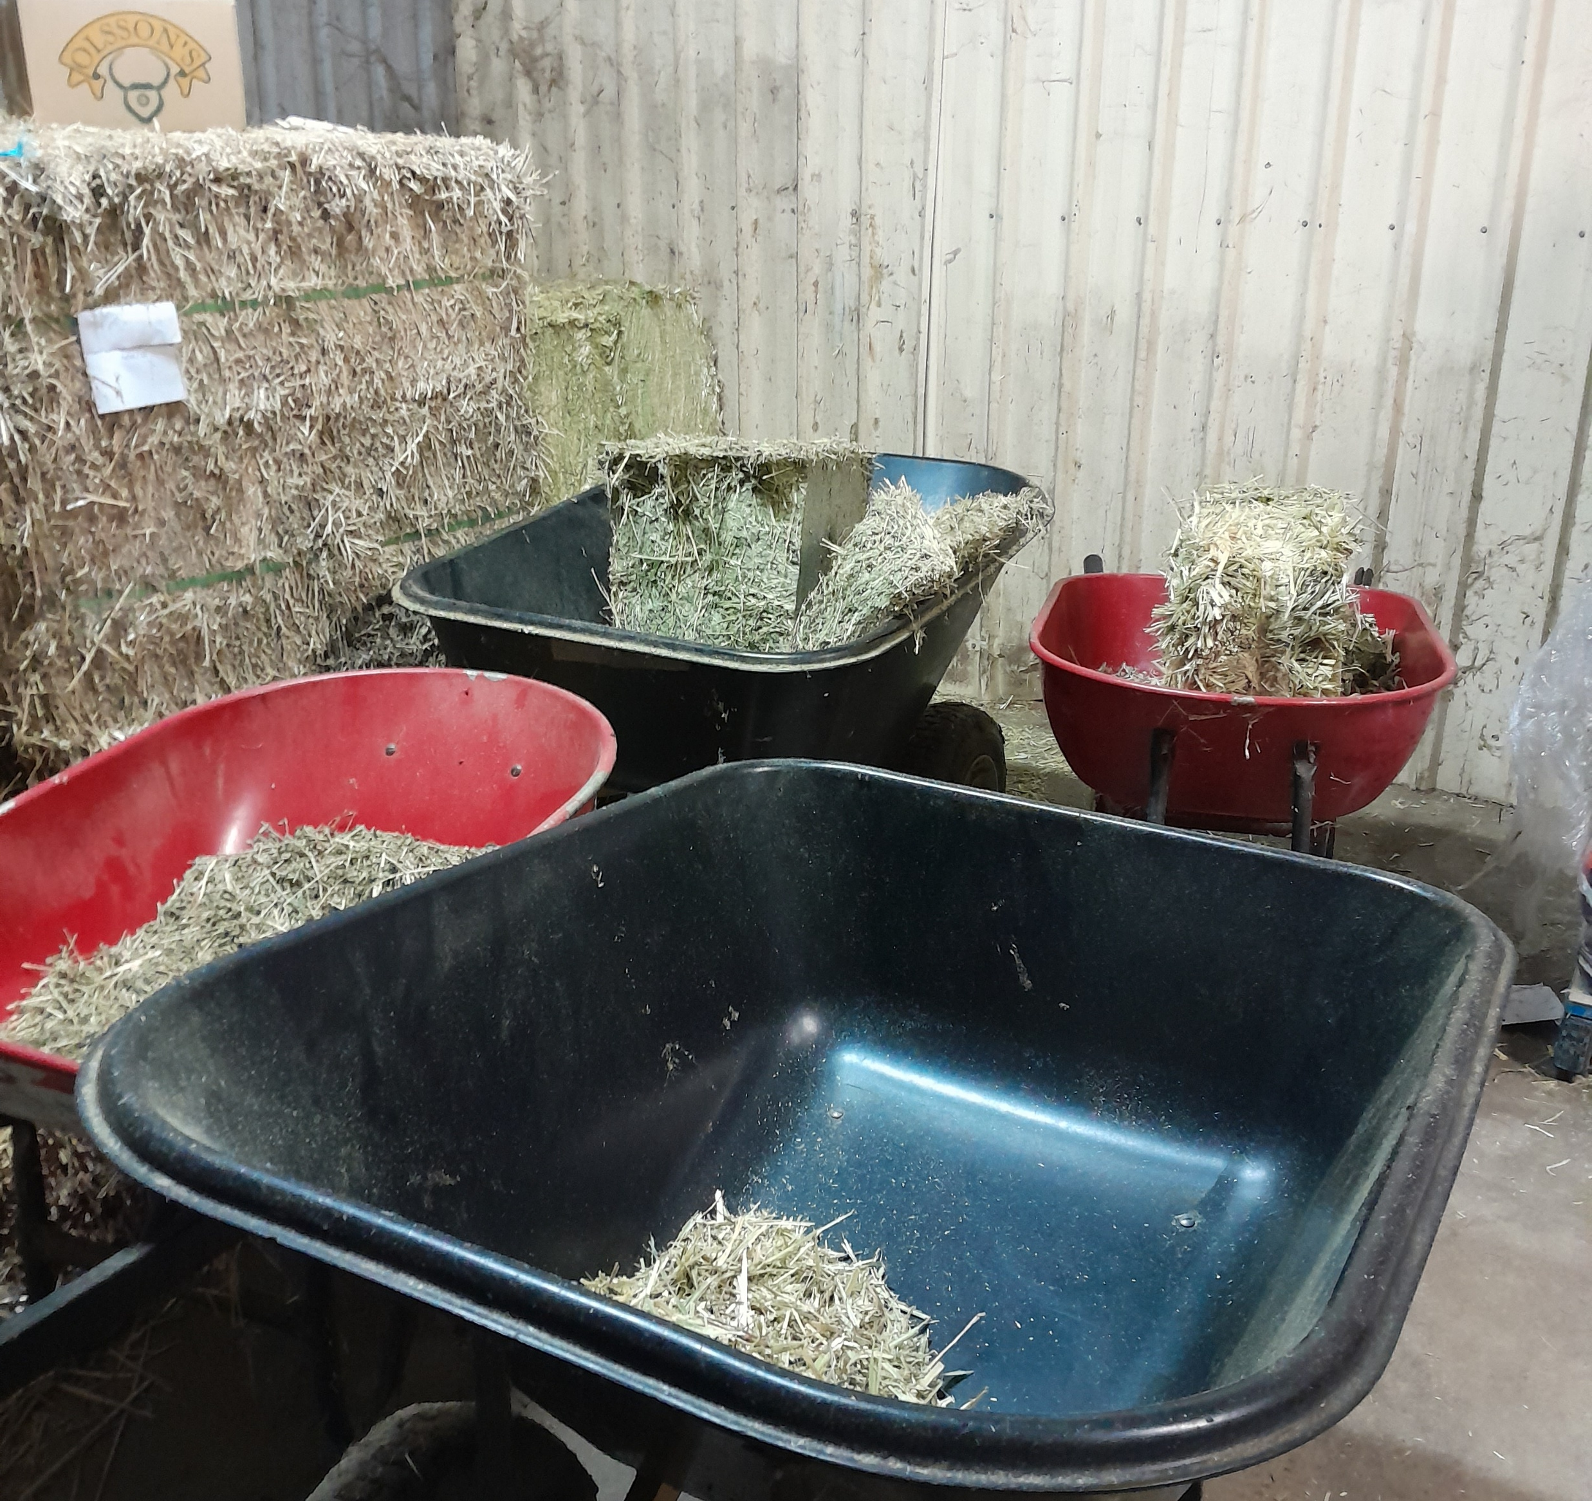
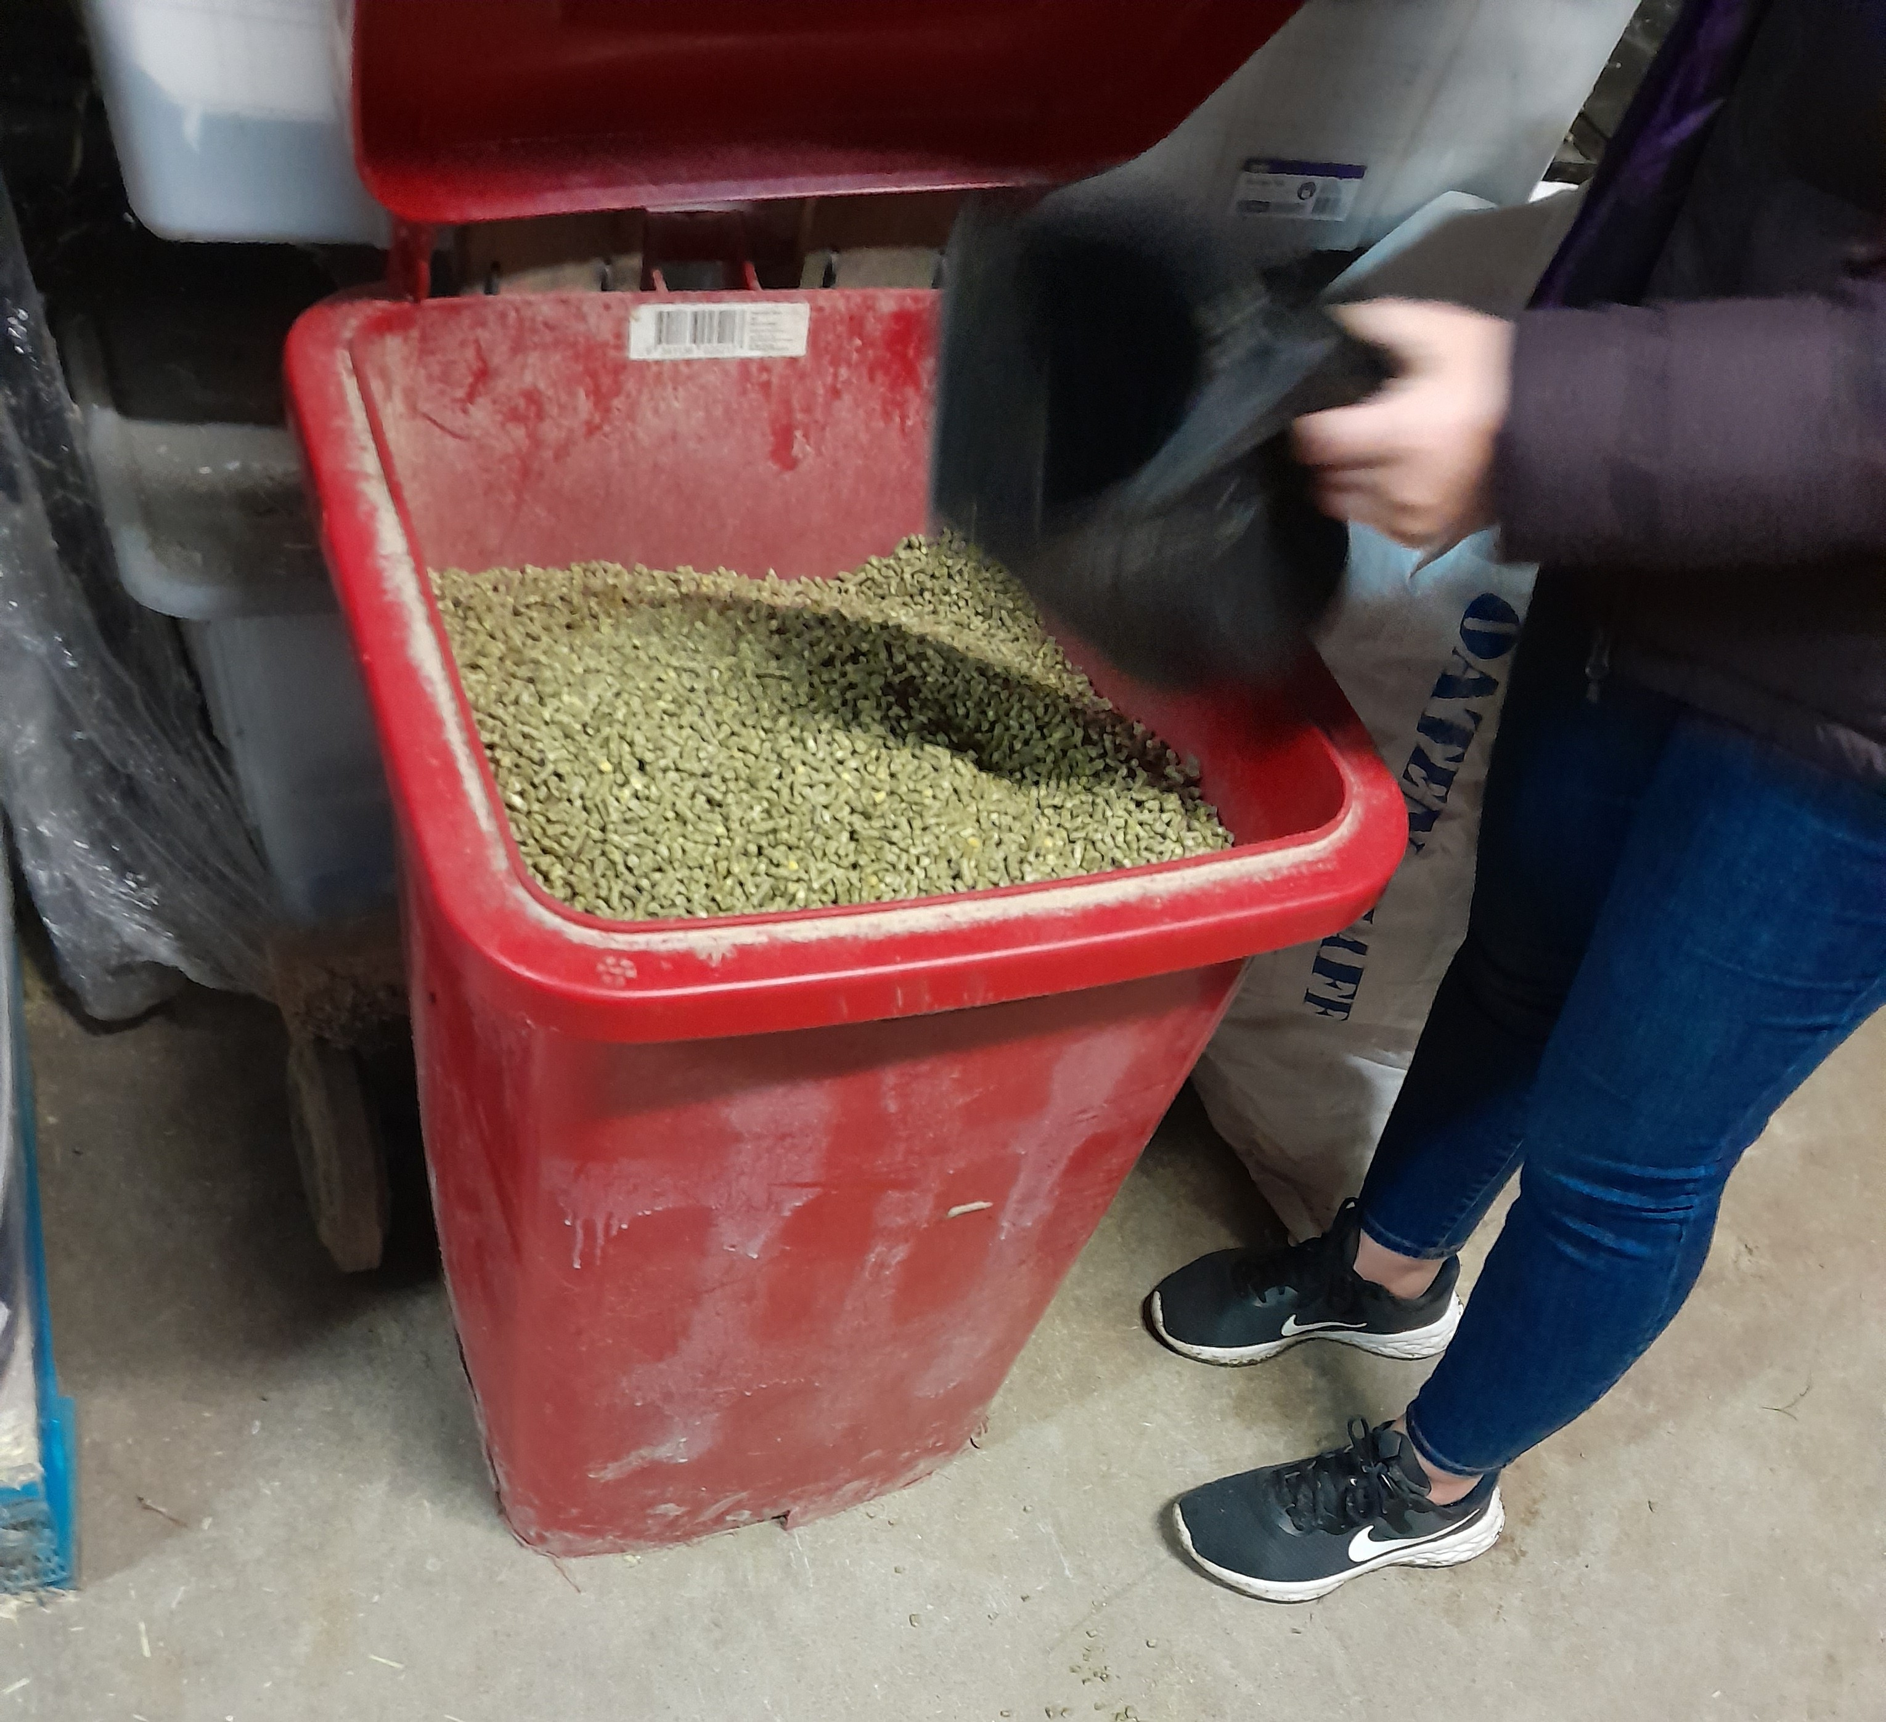
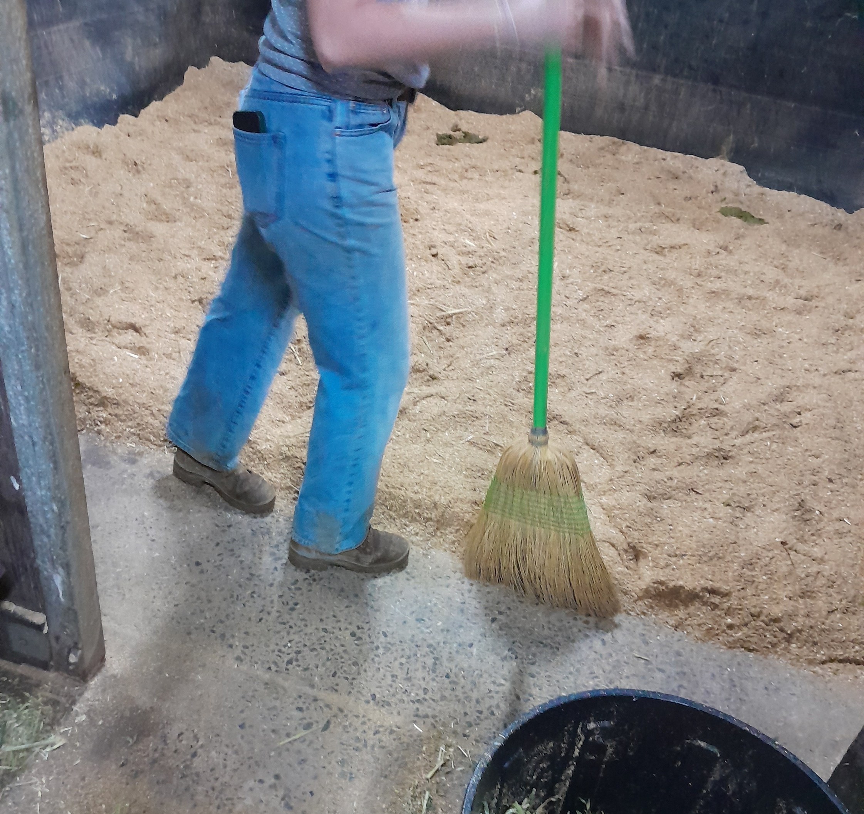
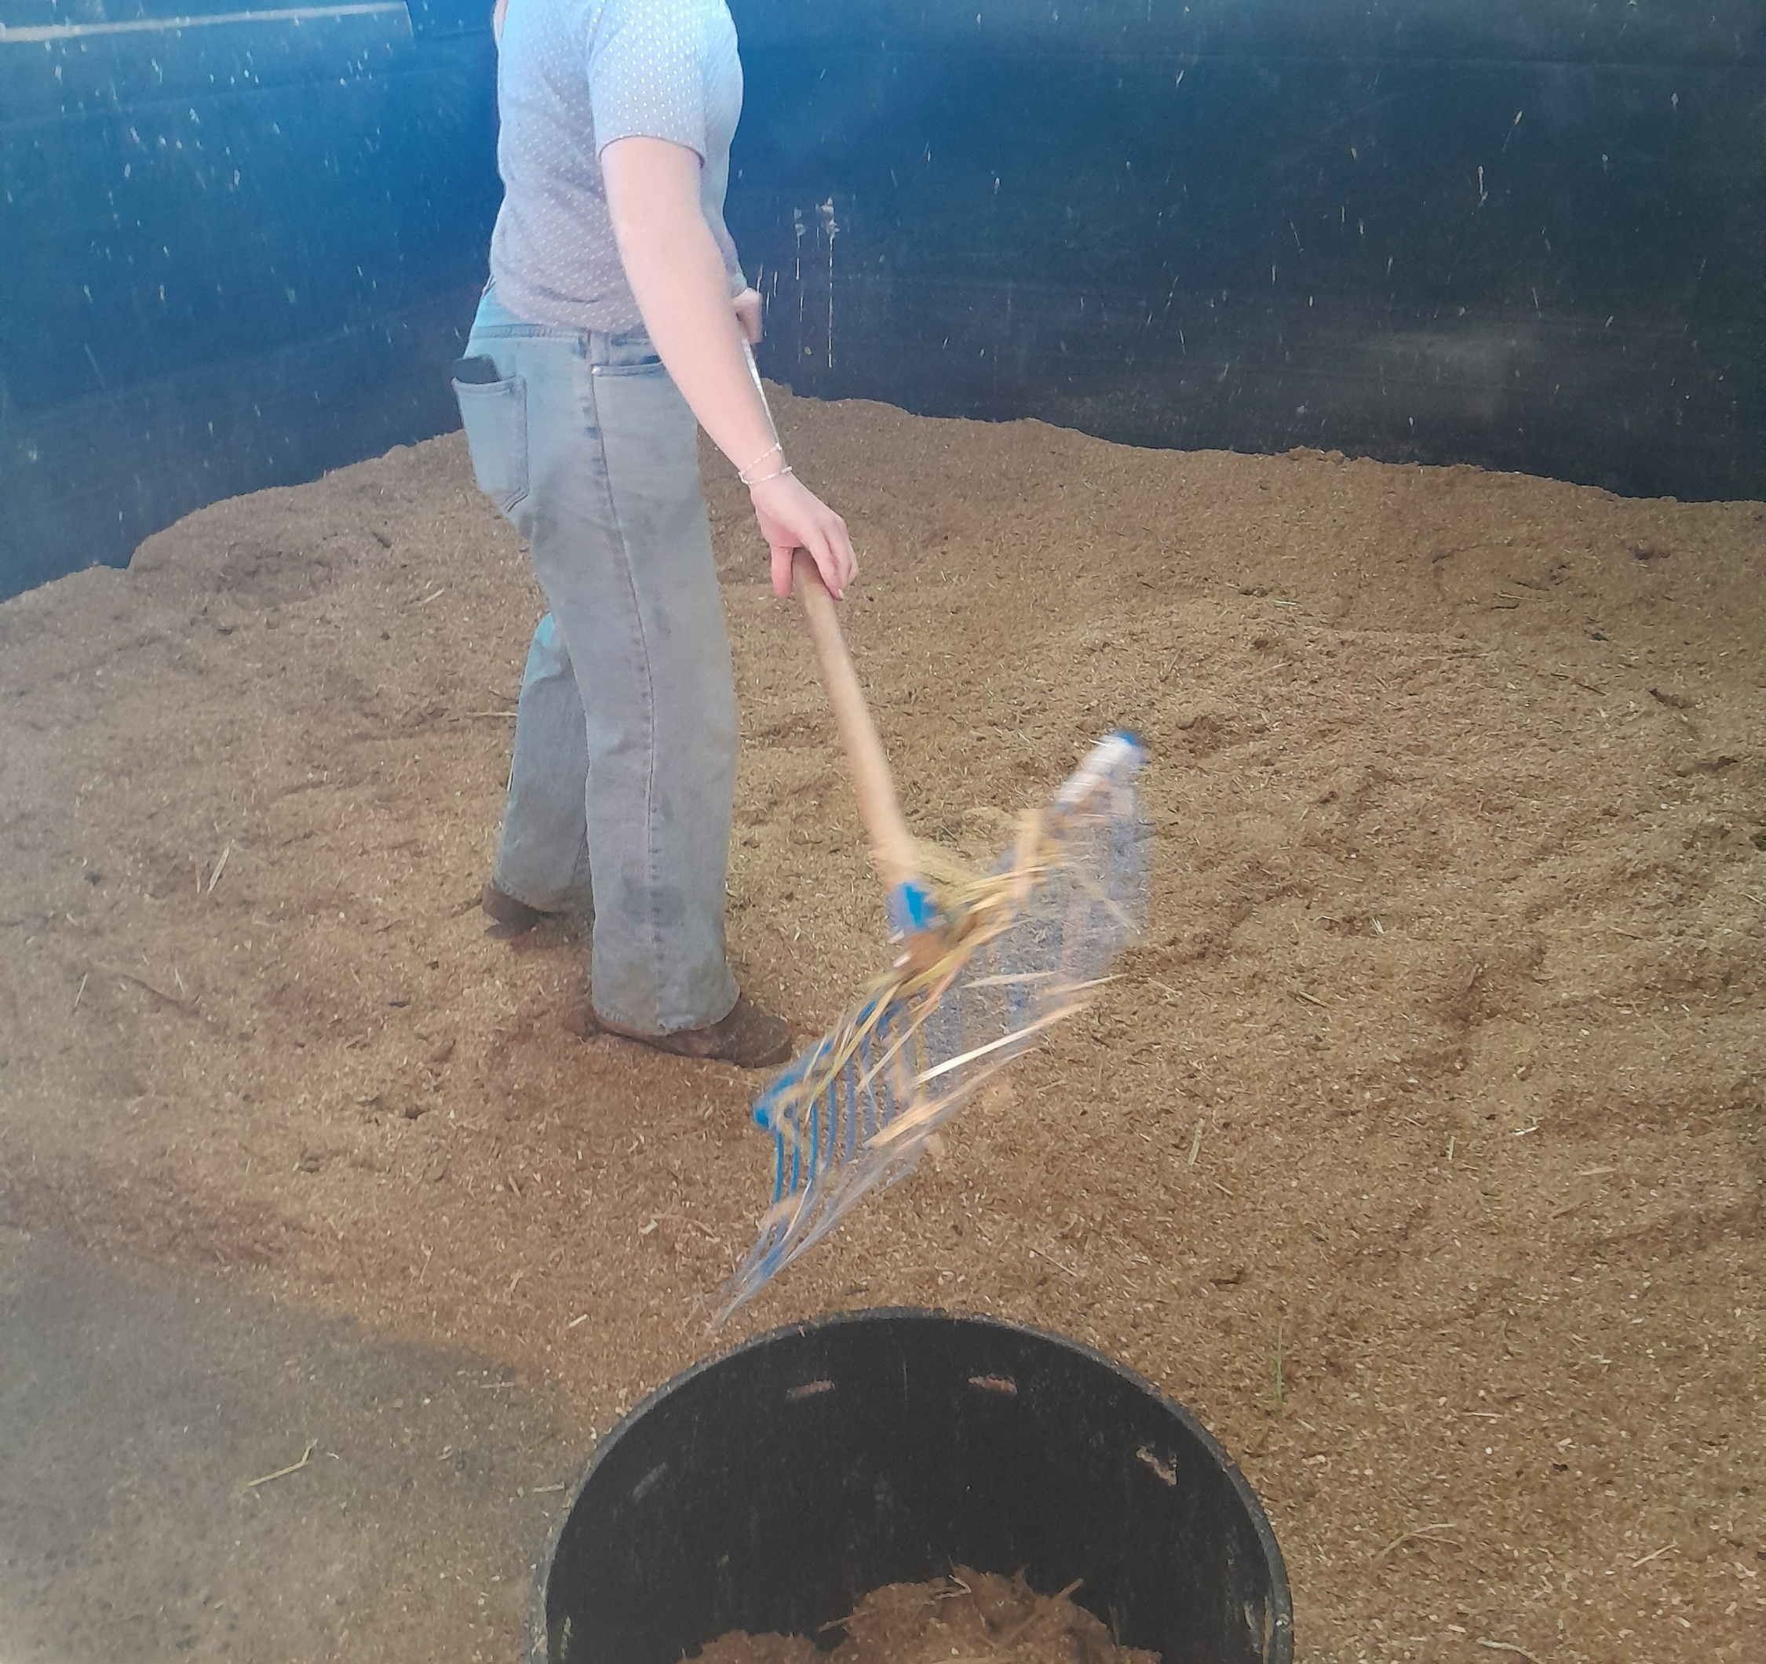
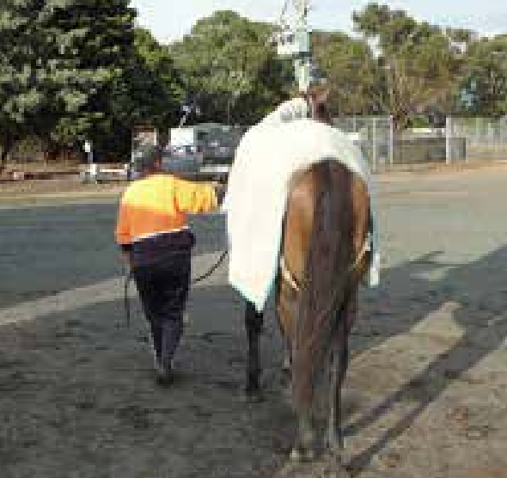
Wheelbarrow to transport hay
Scooping feed
Sweeping stable floor
Raking material into waste disposal bin – cleaning of stable
Leading Horse

