Slide 1
Administration Staff Member
Sedentary
Primarily based in a small office onsite at the stables, the role involves managing a wide range of tasks including data entry, record keeping, correspondence, stakeholder communication, invoicing, wage processing and event registration. The position may require mobility around the racecourse and stables to support operational needs and stakeholder engagement.
Administrative staff work primarily indoors within a small office located onsite at the stables. However, they may also be required to move around other areas of the racecourse to support operations, attend to stakeholder needs, or assist with event-related tasks, as necessary.
Casual employment, start and finish times may vary
Breaks in alignment with industry standards
Casual clothing and enclosed shoes
Computer, keyboard, mouse, phone, headset, desk, ergonomic chair.

Slide 3
Job Task | Frequency | Classification
Email Inbox Management and Administrative Support Tasks Responsible for managing shared and individual email inboxes by monitoring, prioritising, and responding to correspondence in a timely and professional manner. Provides general administrative support including drafting documents, scheduling meetings and maintaining records. | Frequent | Sedentary
Data Entry Management, Filing and Record Keeping Tasks include keeping record of race entries, staff absences, licensing and permit details, meeting agendas and keeping track of stakeholder information. | Frequent | Sedentary
Customer and Stakeholder Engagement Responsible for handling stakeholder phone calls with professionalism and efficiency, including communicating with horse owners and providing images or videos of stable horses as required. Liaises with internal staff regarding rosters, shift changes, and absences to ensure smooth daily operations. Responds promptly to email enquiries related to race or event administration, supporting timely coordination and accurate information sharing. | Frequent | Sedentary

Slide 4
Job Task | Frequency | Classification
Invoicing and Finance Management Responsible for completing invoicing for feed, stable equipment, and other essential resources, ensuring accuracy and timely processing. Manages financial tasks including processing staff wages, race entry fees, and other expenses associated with the daily operations of the stable business, maintaining clear records for budgeting and accountability purposes. | Frequent | Sedentary
Licensing, Permit and Race Day or Event Registration Responsible for completing registrations for upcoming racing events and ensuring all documentation is submitted accurately and on time. Assists with preparing and submitting licence applications for staff. | Frequent | Sedentary

Slide 5
An ability to tolerate extended periods of sitting. High level of computer literacy required. Knowledge of Racing Queensland and understanding of key stakeholders. No specific qualifications or certificates required.

Slide 6
Constant
Constantly sitting at desk to complete all tasks within administrative role.
Occasional
Occasionally will stand and mobilise around office space and /or stables.
Occasional
Occasionally when mobilising around office space and accessing stables.
Frequent
Sustained sitting posture for periods of time.
Rarely
Not a requirement of the role
Rarely
Not a requirement of the role
Rarely
Not a requirement of the role, unless bending to reach for office supplies or unpacking deliveries
Rarely
Not a requirement of the role

Slide 7
Occasional
Required when completing computer-based tasks and or accessing office supplies.
Occasional
Not a typical requirement unless reaching above head to access cupboards or shelving in office.
Rarely
Not a requirement of the role unless unpacking deliveries or reaching for phone, printers and headsets.
Rarely
Not a requirement of the role unless unpacking deliveries.
Frequent
The role requires precise typing and consistent use of a computer mouse to carry out computer-based tasks. It also involves fine motor manipulation for activities such as handling paperwork, filing, and operating office equipment.
Rarely
Not a requirement of the role
Occasional
Required when sitting and working on computer. May be required when reaching for phone, headset and or other office supplies.
Not Applicable
Not a requirement of the role

Slide 8
Rarely
<10kg
Predominately a sedentary role, however, may be required to lift boxes or office supplies less than 10 kilograms in weight.
Rarely
<10kg
See above
Rarely
<10kg
See above
Rarely
<10kg
See above
Rarely
<10kg
See above
Rarely
<10kg
See above

Slide 9
Constant
Required to read fine print on digital screens to complete computer-based work and perform tasks which require precise visual alignment.
Frequently
Required to communicate with colleagues and Racing Queensland stakeholders to perform administrative roles.
Frequently
Required to read and write emails, licenses, event entry policies on a frequent basis.
Frequently
Required to frequently remain concentrated on tasks such as invoicing and processing of wages to minimise errors.
Frequently
Required to use working memory to store information temporarily and integrate new information with existing knowledge. For example, the completion of event entries, invoices and data entry all have an element of working memory.
Frequently
Required to utilise decision making skills when completing all administrative tasks and making timely decisions.
Frequently
Required to remain adaptable and flexible when working with a range of stakeholders.
Frequently
N/A
Frequently
Required to communicate via phone, in person and email with a range of stakeholders.
Notes:
VISUAL DEMANDS
Visual Acuity
Reading fine print or digital screens
Detecting subtle differences or changes
Recognizing objects and details at varying distances
Color Discrimination
Differentiating between colors and shades
Identifying color-coded information
Performing tasks that require accurate color perception
Visual Coordination
Coordinating hand-eye movements
Tracking moving objects
Performing tasks requiring precise visual alignment
Light Sensitivity
Adapting to different lighting conditions
Working under bright or dim lighting
Managing glare or reflections
---------------------------------------------------------------------
AUDIOMETRY DEMANDS
Hearing Acuity
Understanding spoken communication
Detecting alarms, signals, or machinery sounds
Discriminating between different sounds or tones
Listening Skills
Following verbal instructions
Engaging in conversations in noisy environments
Detecting subtle changes in sound for quality control
Sound Localization
Identifying the direction of sounds
Responding to spatial audio cues
Working in environments with complex soundscapes
---------------------------------------------------------------------
ATTENTION AND CONCENTRATION
Sustained Attention
Maintaining focus on a task over a long period
Avoiding distractions
Staying alert during repetitive tasks
Selective Attention
Focusing on relevant information while ignoring irrelevant information
Filtering out background noise
Prioritizing critical tasks
Divided Attention
Managing multiple tasks simultaneously
Switching attention between tasks
Balancing competing demands
---------------------------------------------------------------------
MEMORY
Short-term Memory
Retaining information for immediate use
Recalling instructions or details
Remembering short lists or sequences
Long-term Memory
Storing and retrieving information over extended periods
Recalling procedures and protocols
Retaining knowledge of systems and processes
Working Memory
Holding and manipulating information temporarily
Performing mental calculations
Integrating new information with existing knowledge
---------------------------------------------------------------------
PROBLEM SOLVING
Analytical Thinking
Breaking down complex problems into manageable parts
Identifying patterns and relationships
Evaluating data and evidence
Critical Thinking
Assessing the validity of arguments and claims
Making informed judgments
Identifying biases and assumptions
Decision-Making
Weighing options and consequences
Making timely decisions
Balancing risks and benefits
---------------------------------------------------------------------
LEARNING AND ADAPTATION
Learning Ability
Acquiring new skills and knowledge
Adapting to new methods and technologies
Implementing training and development
Flexibility
Adapting to changing demands and conditions
Modifying approaches based on feedback
Embracing innovation and change
Knowledge Application
Applying theoretical knowledge to practical situations
Integrating new information into existing frameworks
Updating skills and knowledge continuously
---------------------------------------------------------------------
JUDGEMENT AND REASONING
Logical Reasoning
Drawing logical conclusions from available information
Applying principles of logic to problem-solving
Recognizing logical fallacies
Abstract Thinking
Understanding complex concepts and ideas
Thinking creatively and innovatively
Grasping the big picture while focusing on details
Pattern Recognition
Identifying trends and patterns in data
Making predictions based on observed patterns
Detecting anomalies or irregularities
---------------------------------------------------------------------
INFORMATION PROCESSING
Speed of Processing
Quickly understanding and responding to information
Keeping up with fast-paced environments
Managing time-sensitive tasks
Accuracy of Processing
Ensuring precision in handling information
Avoiding errors and mistakes
Maintaining attention to detail
Complexity Handling
Managing and processing complex information
Dealing with ambiguity and uncertainty
Synthesizing information from multiple sources
---------------------------------------------------------------------
INTERPERSONAL COGNITIVE SKILLS
Social Cognition
Understanding and interpreting social cues
Recognizing emotions in others
Navigating social interactions and relationships
Empathy and Perspective-Taking
Understanding others' viewpoints
Demonstrating empathy in communication
Managing interpersonal conflicts

Slide 10
Rarely
Not exposed unless engaging with staff or stakeholders in the stables.
Rarely
N/A
Rarely
N/A
Rarely
N/A
Occasional
While the role typically involves working in well-ventilated indoor environments, there may be occasional exposure to extreme temperatures when moving around outdoor areas of the racecourse or stables.
Occasional
Work within an office space
Occasional
May be exposed to slippery or uneven surfaces when mobilising around outdoor areas of the racecourse or stables.
Occasional
Are not required to work closely with horses.
Rarely
N/A
Rarely
N/A
Rarely
N/A

Slide 11
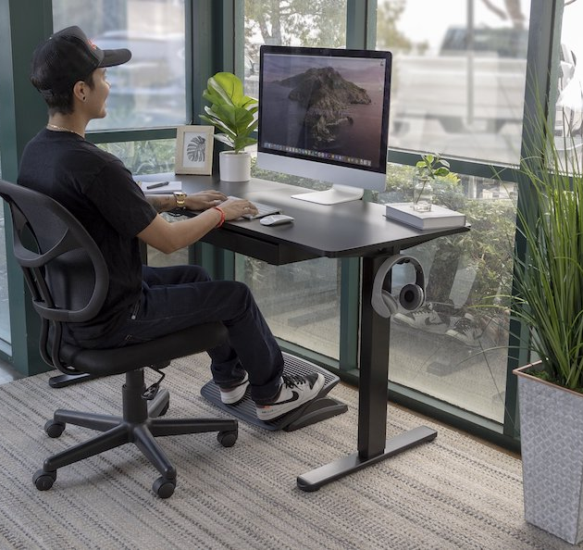

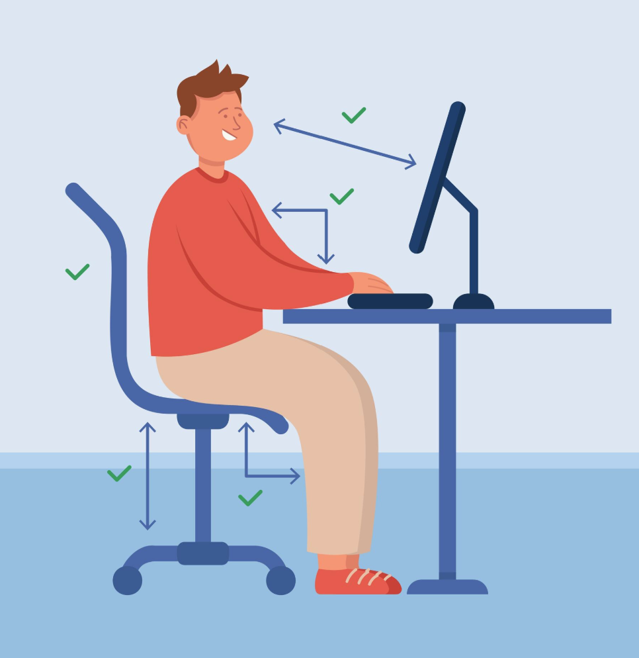


Computer-based Tasks
Answering Phone – general administrative support tasks
Computer-based Tasks – Ergonomic Set up
Filing and Storage
Unpacking Deliveries / Boxes

