Slide 1
Track Rider, Jockey and Apprentice Jockey
Medium Work
A Track Rider (TR) plays a crucial role in the daily preparation and conditioning of racehorses. Their duties include exercising horses, saddling and unsaddling before and after trackwork, and implementing tailored training programs as directed by the foreman or head trainer. Track Riders focus solely on training and conditioning, without participating in competitive racing.
Jockeys and Apprentice Jockeys may undertake similar tasks during trackwork, the key distinction lies in their accreditation and competitive responsibilities. Jockeys and Apprentices are licensed professionals authorized to ride in official races.
Onsite: Track riders work at racecourse locations across Queensland, working outdoors in varying weather conditions and across flexible or irregular hours.
Offsite: Track Riders occasionally travel to offsite locations for training programs and races, working outdoors in varying weather conditions and across flexible or irregular hours.
Often ride in groups of 2-3 and may be required to exercise 8+ horses per shift.
Typically, One (1) piece of work (ride) takes approximately 20 mins.
Trackwork riding is typically between the hours of 4am and 9am.
Jockeys and Apprentice Jockeys who compete in races may participate in set races between the hours of 10am-10pm.
Nil breaks, split shift structure
Helmet and a safety vest which meets industry requirements, safety light attached to helmet when exercising horse, riding boots, long clothes and riding gloves (optional)
Tacking equipment to complete saddling and unsaddling tasks.

Slide 3
Job Task | Frequency | Classification
Preparing Horses for Training(Tacking) Prepare equipment and select appropriate saddle, saddle pad, and girth for each horse Place saddle pad and saddle correctly on horses back. Requires forward reaching, manual dexterity and lifting of 5kgs Secure the grith to ensure comfort and safety. Requires fine motor skills and grip strength Adjust straps and ad check bridle fit. Requires fine motor skills, pull down motion and grip strength Prolonged standing requires when saddling horse Placing bridle on a horse involves forward and lateral reaching. Use of dexterity and grip strength to tighten bridle to fit industry standards. Occasional bending when moving around horse to check fit. | Frequent | Medium Work
Mounting and Dismounting Horse Trackwork riders are required to mount and dismount multiple horses during each shift. This task involves a combination of strength, flexibility, coordination, balance, and horse handling skills. It must be performed quickly but safely, often while the horse is alert or fresh. The leg-up method is a common and efficient way for trackwork riders to mount horses, especially when speed, rider size, or the horse’s height makes mounting from the ground or a block impractical. This method involves a second person lifting the rider onto the horse using coordinated timing and strength. Good core strength and balance to coordinate with the lift. Flexibility and mobility to swing the leg over mid-air. | Frequent | Medium Work
Exercising Horse Trackwork riders are responsible for exercising thoroughbred horses according to the trainer’s instructions. This includes walking, trotting, cantering, and galloping horses under saddle, often in a structured workout on a training track or in a designated riding area. Report on horses' performance and behaviour to trainer. Interpersonal communication and information processing required. Requires strong core strength and balance to remain centered in the saddle. Sustained use of leg muscles and grip strength for cues and control. Endurance and cardiovascular fitness to ride multiple horses per session. Tolerance for early morning starts, cold weather, and repetitive high-intensity work. High degree of situational awareness—including other horses, riders, and track rules. | Frequent | Medium Work

Slide 4
Race Riding Jockeys are licensed professionals responsible for riding racehorses in competitive events. The role requires extreme physical fitness, tactical intelligence, and elite riding skill. Race riding includes pre-race preparations, strategic in-race decision-making, and post-race debriefing, all within a highly regulated, high-risk environment. Lightweight but strong build—strict weight maintenance regime (often under 55 kilograms). Exceptional balance, agility, and core strength to stay secure at high speeds. Fine motor skills for rein control and race communication. Rapid decision-making under pressure. Strong situational awareness—including position, pace, other runners, and rules. | Frequent | Heavy Work

Slide 5
High level of physical stamina. Knowledge of equestrian skills, horse care and tack requirements. Understanding of behaviour and health concerns for horse. Lifting capacity to 10 kilograms to manage tack. Ability to bend, forward, overhead and lateral reach when positioning tack. Strength through legs to hold riding position, stoop, need to have high level of stamina. Balance and coordination skills. Core strength. Grip strength to navigate reins.

Slide 6
Frequent
Track riders (TR) are required to remain in ‘riding position’ constantly exercising horse and are required to sit on saddle when walking horse to course.
Frequent
TR are required to standing when completing duties including saddling, mounting and dismounting of horse.
Frequent
TR are required to walk when leading house. TR rarely run as apart of their role.
Constant
TR are required to sustain posture and balance constantly when exercising horse to remain in riding position .
Constant
TR are required to constantly be in a slight squat and crouch when in riding position.
Infrequent
TR are not required to kneel.
Frequent
TR are not required to bend unless supporting when saddling and unsaddling tasks such as fitting saddle pad or gathering equipment such as cloths to wipe sweat off horse.
Infrequent
TR are not required to crawl.

Slide 7
Frequent
TR are required to forward reach frequently when completing tasks such as exercising horse, reaching for reins and fitting saddles.
Frequent
TR are required to complete overhead task such as fitting a bridle to a horse.
Frequent
TR are required to side or laterally reach when securing tack on horse. Occasionally required to laterally reach when either mounting or dismounting horse, depending on Riders mounting technique.
Frequent
TR are required to sustain a stooping position when in riding position.
Constant
TR are required to complete fine motor coordination and manual dexterity constantly when papering and riding horse. For example, holding onto reins and tightening saddle.
Constant
TR are required to have signifcant grip strength to guide and maintain balance with riding horse
Frequent
TR are required to utilise trunk rotation and twisting when mounting, dismounting and sustaining balance in ‘riding position’
Infrequent
TR are not required to drive.

Slide 8
Infrequent
N/A
N/A
Frequent
5kg
TR are frequently required to lift from waist to shoulder height when fitting and removing saddles.
Infrequent
Up to 5kg
TR may be infrequently required to lift shoulder to overhead when fitting bridle onto horse.
Infrequent
Body Weight
TR are required to push themselves onto and off horse when mounting and dismounting. TR are required to maintain push force through lower limbs when in riding position.
Frequent
15kg
TR may need to apply a pulling force of up to approximately 15 kg when holding the reins during riding.
Frequent
5kg
TR are required to carry tack equipment before and after exercising horse.

Slide 9
Constant
TR are required to have strong eyesight to conduct their everyday duties and detect potential risks and hazards when exercising horse.
Constant
TR are required to have strong hearing to ensure they are aware of potential risks and hazards, following instructions and communicating effectively when riding in groups.
Frequent
TR are required to read training programs to conduct their everyday duties.
Constant
TR required to demonstrate attention to detail and concentration constantly to conduct every day tasks including reading training programs, guiding horse, following train programs when exercising horses.
Constant
Constant element of everyday duties. Combination of long term and working memory required.
Constant
Constant demand of everyday duties, particularly when adapting to the environmental and biological factors. High order decision making skills required.
Constant
High level of flexibility required to adjust to environmental and biological factors.
Constant
TR are required to process information quickly to understand and respond to environmental or biological factors. Accuracy of processing is required to avoid and minimise errors.
Constant
TR are required to recognise the emotions in horses, navigate social interactions with other riders, trainers and manage interpersonal conflicts if these arise.
Notes:
VISUAL DEMANDS
Visual Acuity
Reading fine print or digital screens
Detecting subtle differences or changes
Recognizing objects and details at varying distances
Color Discrimination
Differentiating between colors and shades
Identifying color-coded information
Performing tasks that require accurate color perception
Visual Coordination
Coordinating hand-eye movements
Tracking moving objects
Performing tasks requiring precise visual alignment
Light Sensitivity
Adapting to different lighting conditions
Working under bright or dim lighting
Managing glare or reflections
---------------------------------------------------------------------
AUDIOMETRY DEMANDS
Hearing Acuity
Understanding spoken communication
Detecting alarms, signals, or machinery sounds
Discriminating between different sounds or tones
Listening Skills
Following verbal instructions
Engaging in conversations in noisy environments
Detecting subtle changes in sound for quality control
Sound Localization
Identifying the direction of sounds
Responding to spatial audio cues
Working in environments with complex soundscapes
---------------------------------------------------------------------
ATTENTION AND CONCENTRATION
Sustained Attention
Maintaining focus on a task over a long period
Avoiding distractions
Staying alert during repetitive tasks
Selective Attention
Focusing on relevant information while ignoring irrelevant information
Filtering out background noise
Prioritizing critical tasks
Divided Attention
Managing multiple tasks simultaneously
Switching attention between tasks
Balancing competing demands
---------------------------------------------------------------------
MEMORY
Short-term Memory
Retaining information for immediate use
Recalling instructions or details
Remembering short lists or sequences
Long-term Memory
Storing and retrieving information over extended periods
Recalling procedures and protocols
Retaining knowledge of systems and processes
Working Memory
Holding and manipulating information temporarily
Performing mental calculations
Integrating new information with existing knowledge
---------------------------------------------------------------------
PROBLEM SOLVING
Analytical Thinking
Breaking down complex problems into manageable parts
Identifying patterns and relationships
Evaluating data and evidence
Critical Thinking
Assessing the validity of arguments and claims
Making informed judgments
Identifying biases and assumptions
Decision-Making
Weighing options and consequences
Making timely decisions
Balancing risks and benefits
---------------------------------------------------------------------
LEARNING AND ADAPTATION
Learning Ability
Acquiring new skills and knowledge
Adapting to new methods and technologies
Implementing training and development
Flexibility
Adapting to changing demands and conditions
Modifying approaches based on feedback
Embracing innovation and change
Knowledge Application
Applying theoretical knowledge to practical situations
Integrating new information into existing frameworks
Updating skills and knowledge continuously
---------------------------------------------------------------------
JUDGEMENT AND REASONING
Logical Reasoning
Drawing logical conclusions from available information
Applying principles of logic to problem-solving
Recognizing logical fallacies
Abstract Thinking
Understanding complex concepts and ideas
Thinking creatively and innovatively
Grasping the big picture while focusing on details
Pattern Recognition
Identifying trends and patterns in data
Making predictions based on observed patterns
Detecting anomalies or irregularities
---------------------------------------------------------------------
INFORMATION PROCESSING
Speed of Processing
Quickly understanding and responding to information
Keeping up with fast-paced environments
Managing time-sensitive tasks
Accuracy of Processing
Ensuring precision in handling information
Avoiding errors and mistakes
Maintaining attention to detail
Complexity Handling
Managing and processing complex information
Dealing with ambiguity and uncertainty
Synthesizing information from multiple sources
---------------------------------------------------------------------
INTERPERSONAL COGNITIVE SKILLS
Social Cognition
Understanding and interpreting social cues
Recognizing emotions in others
Navigating social interactions and relationships
Empathy and Perspective-Taking
Understanding others' viewpoints
Demonstrating empathy in communication
Managing interpersonal conflicts

Slide 10
Constant
TR are exposed dust when preparing and riding horse
Infrequent
Not exposed to gases
Infrequent
Not exposed to fumes
Infrequent
TR are exposed to medicated washes and water
Frequent
TR are required to ride and perform duties in varied conditions
Infrequent
TR are not required to work in confined space
Frequent
TR are required to navigate slippery or uneven surfaces
Constant
TR are required to understand horses needs and adapt to changes in behavior
Infrequent
TR are not exposed to hazardous substances, occasionally to medicated washes
Infrequent
TR are not exposed to dangerous good when completing tasks
Constant
TR are exposed to high-risk work when exercising horses at high speeds and being approximately 5 meters from ground at all times.

Slide 11
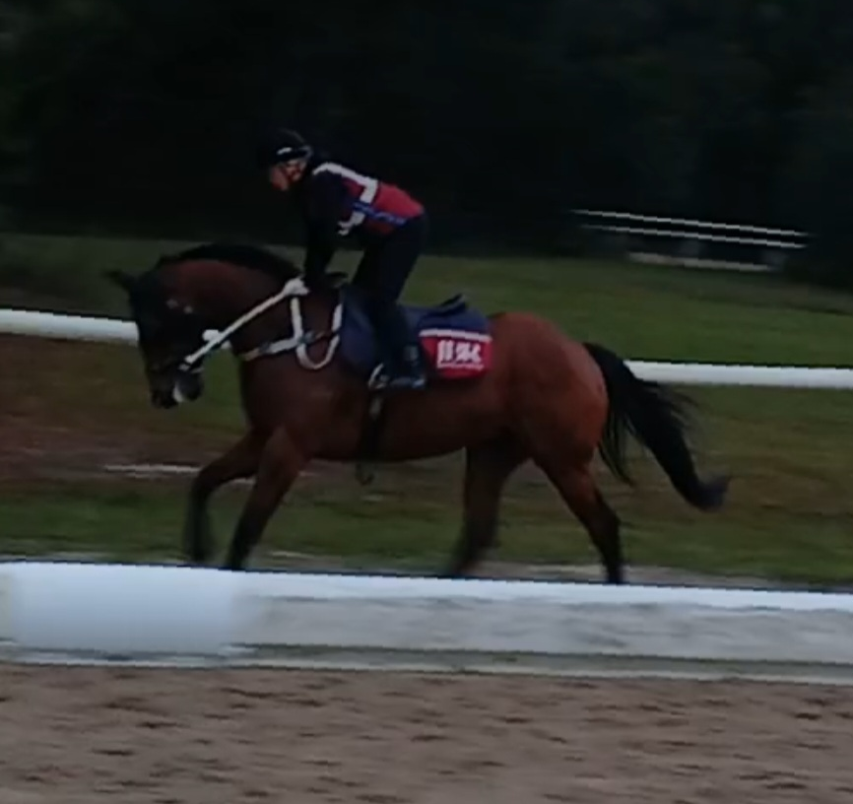
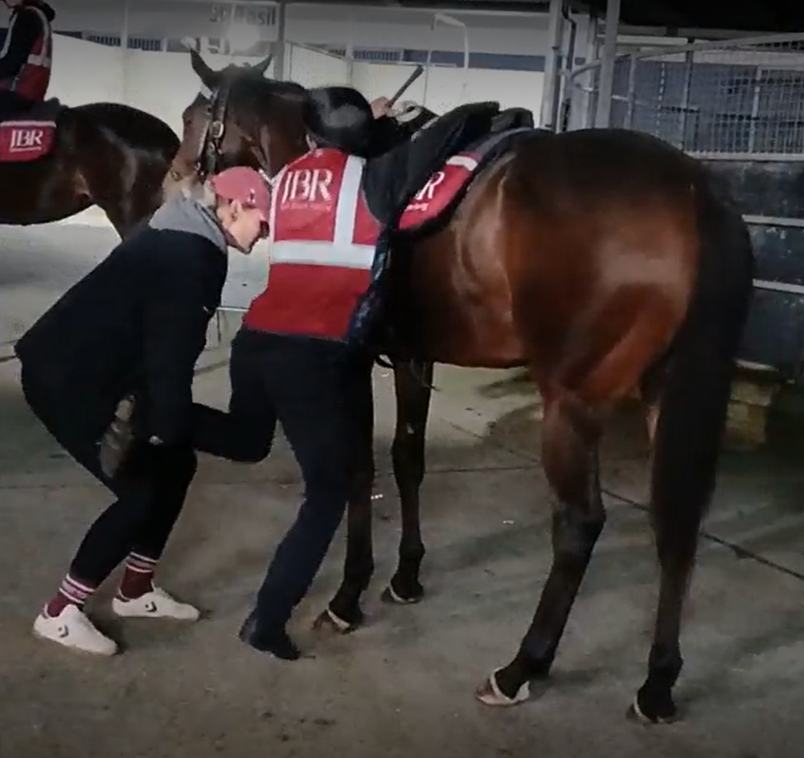
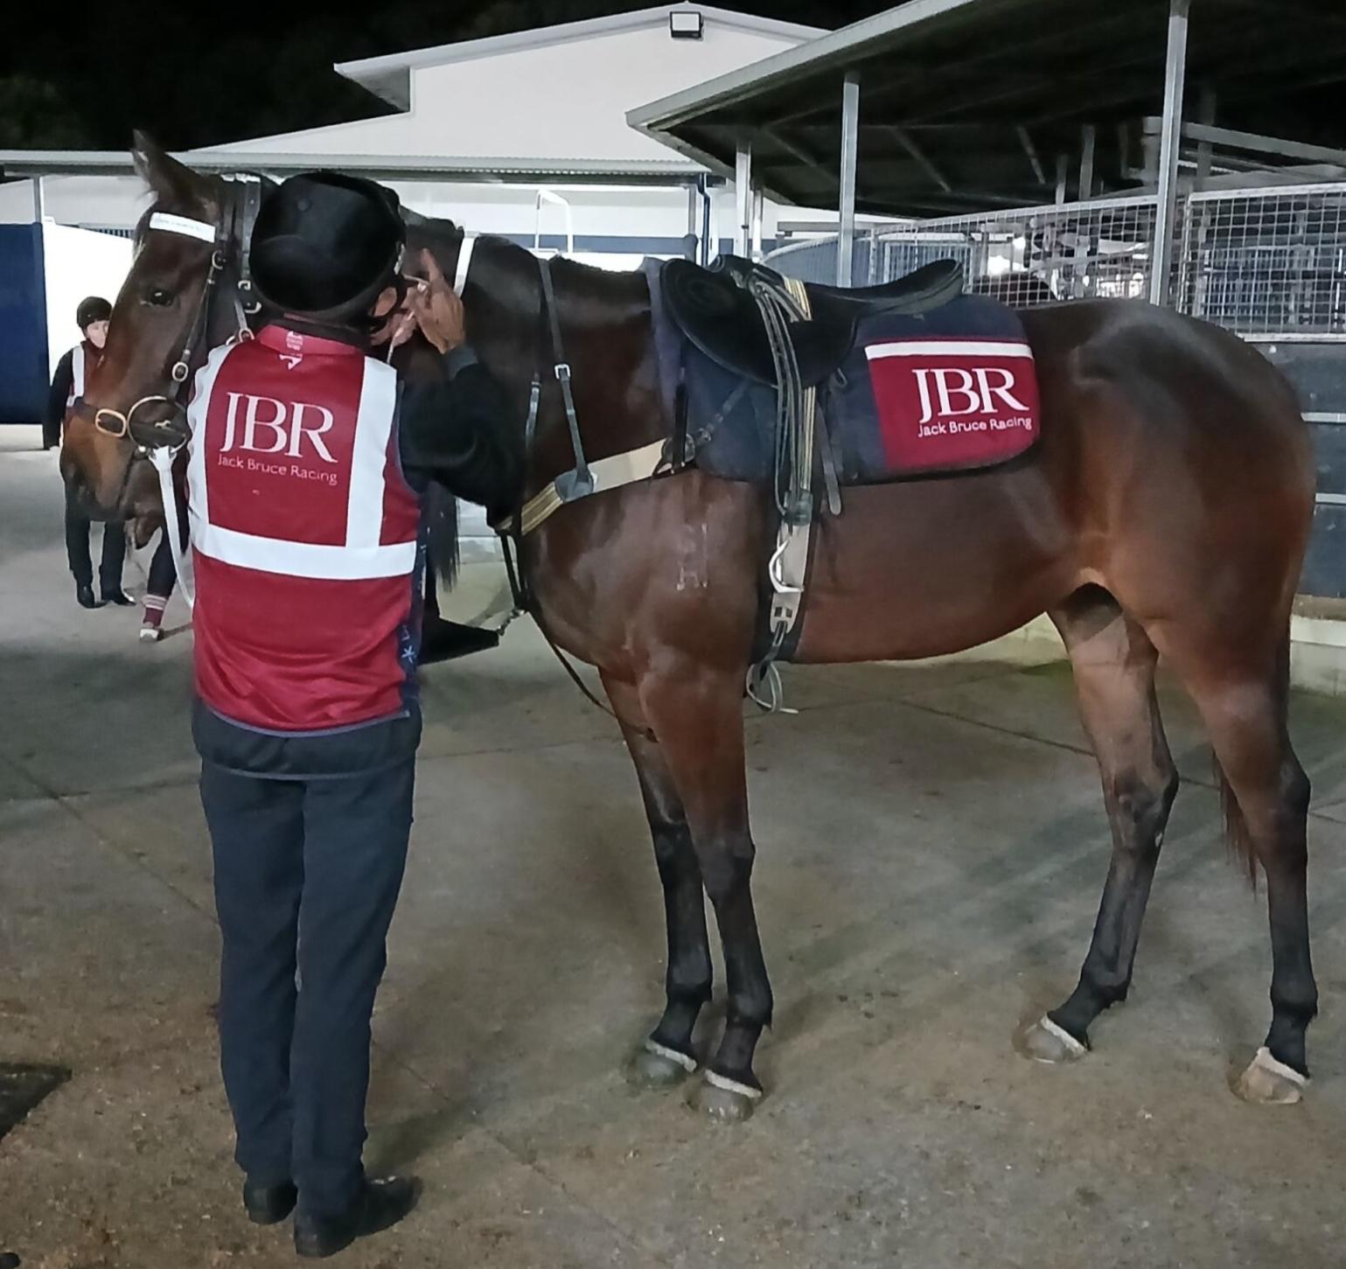
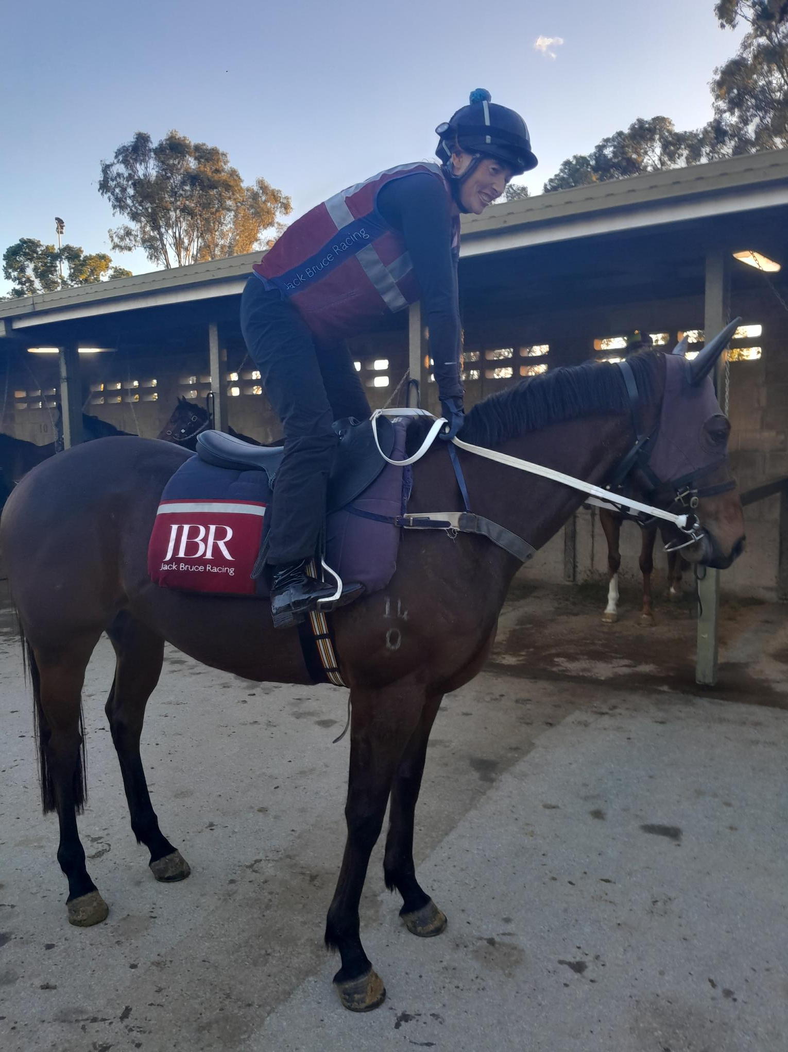
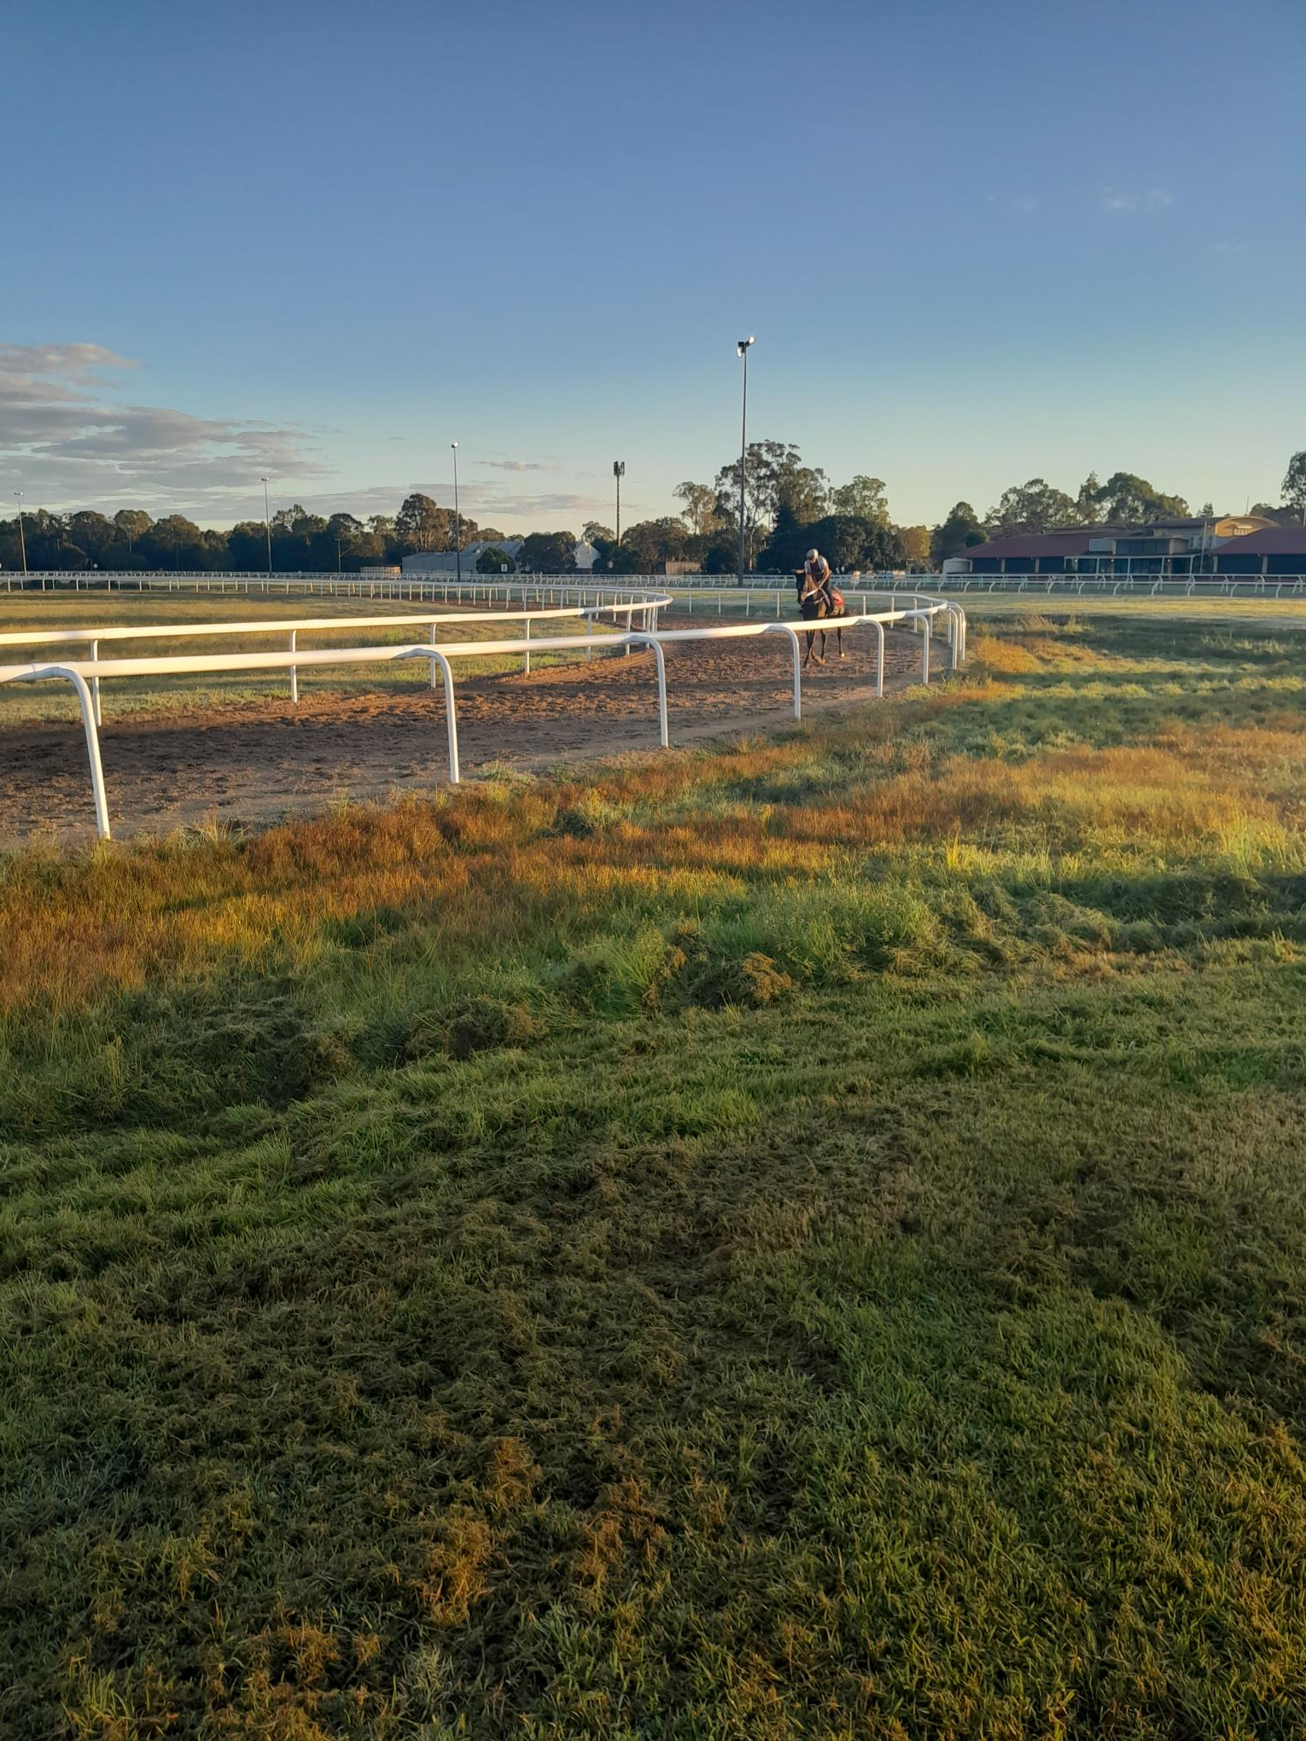
Ridding position
Mounting ‘legged up’
Saddling process
Riding position
Track work example

