Slide 1
Trainer / Trainer Assistant / Foreman
Moderate
Trainers are responsible for the core aspects of running a racing stable. Depending on the induvial business requirements, this may include – liaising with all staff members, directing track work riders, developing training programs, and discussing horse health and performance. They also play a pivotal role in supporting Stablehands and jockeys with tasks such as saddling, unsaddling, exercising, and guiding horses Trainers are also responsible for providing regular updates to owners, communicating with Racing Queensland stakeholders, suppliers and organising racing schedules.
Trainers complete much of their work outdoors in stables, yards, and on training tracks. They are regularly exposed to changing weather conditions, including heat, rain, and cold, and must safely navigate uneven surfaces, biological hazards, and other environmental risks.
Trainers work varied hours based on the needs of the business. As per the Horse and Greyhound Award [MA000008], ordinary hours differ depending on type of employment, up to 38 hours per week unless an employer asks them to work reasonable extra hours.
They typically work split shifts, such as 4:00 am to 9:00 am and 2:00 pm to 6:00 pm. However, will complete stakeholder communication in between shifts .
Breaks are provided in accordance with Racing Queensland legislation; however, due to the split shift system, breaks are not typically taken during working hours.
Trainers are required to wear appropriate personal protective equipment (PPE), including enclosed shoes and casual, comfortable clothing suitable for physical work.
N/A

Slide 3
Job Task | Frequency | Classification
Training programs Develop and write daily training programs tailored to the needs of each horse. Allocate and direct track work riders to ensure horses are exercised according to the training plan. Coordinate and oversee the exercise process during both morning and afternoon shifts. Ensure the training program is clearly documented and left in the stables for riders to access and follow. Monitor compliance with training plans and provide guidance or adjustments as needed. | Frequent | Light Work
Staff member directing and communication Communicate effectively and use interpersonal skills to discuss the daily training program with track work riders and jockeys. Conduct one-on-one discussions with riders to allocate horses for each shift. Check in with riders after exercise sessions to review horse health, behaviour, and performance. Record observations and make notes to adjust subsequent training sessions as required. Liaise with owners to provide updates on horse progress and inform them of upcoming race schedules. | Frequent | Light Work
Administrative tasks Develop and maintain the training roster for track work riders, jockeys, and apprentice jockeys. Determine and coordinate the daily training schedules to ensure efficient use of resources and personnel Assist in the preparation and submission of race entries. Manage the timely payment of entry fees associated with races. Engage with key stakeholders, including suppliers and horse owners, through various communication channels such as phone calls, emails, and video sharing. Provide regular updates and information to stakeholders regarding training progress and related activities. | Frequent | Sedentary Work

Slide 4
Job Task | Frequency | Classification
Horse care tasks Oversee the general well-being and health of horses under training. Monitor horses for signs of injury, illness, or distress and coordinate with veterinary staff as needed. Ensure horses receive proper grooming, feeding, and hydration in line with training and welfare protocols. Supervise stable cleanliness and maintenance to provide a safe and healthy environment for horses. Monitor horses post-exercise to assess recovery and address any immediate care needs. | Occasional | Moderate
Notes:
Removed as per Nathan’s comment:
Prepare horses for training or racing by ensuring correct saddling and tack placement.
Inspect saddles, bridles, and other equipment to ensure they are in good condition and properly fitted.
Assist or directly perform the saddling process, adjusting equipment as necessary for comfort and safety.
Carefully remove saddles and tack after training sessions or races to prevent discomfort or injury.
Inspect equipment post-use for wear or damage and arrange for cleaning or repairs.

Slide 5
Possible Job Tasks | Frequency | Classification
Mounting and Dismounting Horse​ Trainers are occasionally are required to mount and dismount multiple horses during each shift when trackwork is being performed. This task involves a combination of strength, flexibility, coordination, balance, and horse handling skills. It must be performed quickly but safely, often while the horse is alert or fresh.​ The leg-up method is a common and efficient way for trainers to mount horses, especially when speed, rider size, or the horse’s height makes mounting from the ground or a block impractical. This method involves a second person lifting the rider onto the horse using coordinated timing and strength.​ Good core strength and balance to coordinate with the lift.​ Flexibility and mobility to swing the leg over mid-air.​ | Occasional | Medium​
Riding Horse​ Trainers are occasionally required to ride horses during trackwork. This includes walking, trotting, cantering, and galloping horses under saddle, often in a structured workout on a training track or in a designated riding area. ​ Requires strong core strength and balance to remain centered in the saddle.​ Sustained use of leg muscles and grip strength for cues and control.​ Endurance and cardiovascular fitness to ride multiple horses per session.​ Tolerance for early morning starts, cold weather, and repetitive high-intensity work.​ High degree of situational awareness—including other horses, riders, and track rules.​ | Occasional​ | Medium​

Slide 6
Trainers are required to lift and carry weights up to 15 kilograms safely, primarily from ground to waist level. Dexterity and fine motor skills required Tasks demand prolonged standing and frequent physical movements including bending, twisting, squatting, stooping, forward, and overhead reaching, essential for saddling, unsaddling, and horse care activities An understanding of equine health, exercise needs, and training programs is necessary Trainers must also demonstrate high-level interpersonal skills to communicate and collaborate with horse owners, jockeys, suppliers, and veterinary staff efficiently Computer literacy skills In addition to, on an occasional basis: Ability to bend, forward, overhead and lateral reach when positioning tack ​ Strength through legs to hold riding position, stoop, need to have high level of stamina​ Balance and coordination skills ​ Core strength ​ Grip strength to navigate reigns

Slide 7
Rarely
Trainers may be required to remain seated while performing administrative duties such as handling phone calls, managing emails, completing paperwork, and coordinating supply chain activities.
Constant
Trainers are required to stand continuously while in the stables, engaging with track work riders, jockeys, and apprentices. They also stand during the coordination of horse exercise and actively participate in tasks such as saddling, unsaddling, and monitoring horse performance, behavior, and health.
Frequent
Trainers frequently ambulate throughout the stables, walk alongside horses, organise equipment and tack, and monitor track work activities.
Frequent
Trainers are required to sustain posture and balance constantly when riding horse during trackwork to remain in riding position.
Occasional
Trainers may be required to squat or crouch to assist with the saddling and unsaddling process.
Rarely
N/A
Occasional
Trainers may be required to bend while assisting with saddling and unsaddling, as well as when picking up equipment and tack.
Rarely
N/A

Slide 8
Occasional
Trainers are required to engage in forward reaching during saddling and unsaddling tasks. This includes reaching across the horse's body to secure equipment such as straps, and bridles, ensuring proper fit and safety. These movements are essential for effective tack application and require careful handling to maintain control and ensure the comfort and wellbeing of the horse. Also applicable to reaching for reins when riding horse.
Occasional
Trainers are occasionally required to perform overhead reaching when retrieving equipment and tack stored at height, as well as when inspecting horses for injuries, particularly along the neck and upper limbs.
Occasional
Trainers are required to side or laterally reach when securing tack on horse. Occasionally required to laterally reach when either mounting or dismounting horse, depending on mounting technique. ​
Occasional
Trainers are required to sustain a stooping position when in riding position.
Frequent
Trainers are required to use fine motor skills and manual dexterity for a range of tasks, including writing training programs, saddling and unsaddling horses, and performing administrative duties such as completing computer-based tasks, handling paperwork, processing race entries, and managing phone calls and emails. Also applicable to holding onto reins when riding horse.
Frequent
Trainers are required to have a grip strength of approximately 25 kilograms to effectively perform manual handling tasks, including guiding horses, positioning tack, and maintaining balance when riding horse.
Frequent
Trainers frequently use trunk rotation and twisting movements when assisting with horse exercise, such as placing horses on the walker, or when positioning tack. Also, when mounting, dismounting and sustaining balance when riding horse.
Occasional
Trainers may be required to drive and transport horses to and from events or training locations, such as taking them to the beach for specialised conditioning sessions.

Slide 9
Occasional
15 kilograms
Trainers may be required to assist with lifting tack, as well as saddling and unsaddling horses.
Occasional
15 kilograms
To position tack, trainers need to lift equipment from waist to shoulder height.
Occasional
15 kilograms
See above
Occasional
10 kilograms
See above. Additionally, trainers may be required to push themselves onto and off horse when mounting and dismounting and maintain push force of their bodyweight through lower limbs when in riding position.​
Occasional
10 kilograms
Trainers are occasionally required to guide horses and place them on the walker for exercise. Securing tack may also involve pulling motions. Also required to apply pulling force of approximately 15 kilograms when holding the reins during riding horse.
Occasional
15 kilograms
Trainers are required to carry tack and other equipment to and from the stables, training areas, and transport vehicles. This task often involves lifting and moving saddles, bridles, and various grooming tools.

Slide 10
Constant
Trainers are required to read fine print and digital screens accurately to complete various administrative tasks, including reviewing phone numbers, managing emails, and processing paperwork.
Frequent
To effectively communicate with track work riders, jockeys, and apprentice jockeys, trainers are required to utilise active listening skills.
Frequent
Trainers are responsible for writing training programs, responding to emails, and communicating with key stakeholders.
Constant
Trainers are required to maintain sustained attention and concentration when writing training programs, communicating with staff and stakeholders, supporting with horse care tasks, and observing and recording horse performance, behavior, and health.
Constant
Trainers are required to utilise working memory to adjust training programs by integrating new information with pre-existing knowledge, ensuring training remains responsive and effective.
Frequent
Trainers are required to make daily decisions to ensure training programs are properly calibrated and horses are exercised appropriately to meet their individual needs and performance goals.
Frequent
Frequent
Trainers are required to coordinate various stakeholders, including stablehands, track work riders, jockeys, and apprentice jockeys, to ensure daily operations and shifts run smoothly and efficiently.
Frequent
Trainers work closely with stablehands, riders, and jockeys, requiring strong social awareness and the ability to recognize emotions in others. These skills support effective communication, conflict resolution, and teamwork, helping trainers maintain smooth operations and positive working relationships.
Notes:
VISUAL DEMANDS
Visual Acuity
Reading fine print or digital screens
Detecting subtle differences or changes
Recognizing objects and details at varying distances
Color Discrimination
Differentiating between colors and shades
Identifying color-coded information
Performing tasks that require accurate color perception
Visual Coordination
Coordinating hand-eye movements
Tracking moving objects
Performing tasks requiring precise visual alignment
Light Sensitivity
Adapting to different lighting conditions
Working under bright or dim lighting
Managing glare or reflections
---------------------------------------------------------------------
AUDIOMETRY DEMANDS
Hearing Acuity
Understanding spoken communication
Detecting alarms, signals, or machinery sounds
Discriminating between different sounds or tones
Listening Skills
Following verbal instructions
Engaging in conversations in noisy environments
Detecting subtle changes in sound for quality control
Sound Localization
Identifying the direction of sounds
Responding to spatial audio cues
Working in environments with complex soundscapes
---------------------------------------------------------------------
ATTENTION AND CONCENTRATION
Sustained Attention
Maintaining focus on a task over a long period
Avoiding distractions
Staying alert during repetitive tasks
Selective Attention
Focusing on relevant information while ignoring irrelevant information
Filtering out background noise
Prioritizing critical tasks
Divided Attention
Managing multiple tasks simultaneously
Switching attention between tasks
Balancing competing demands
---------------------------------------------------------------------
MEMORY
Short-term Memory
Retaining information for immediate use
Recalling instructions or details
Remembering short lists or sequences
Long-term Memory
Storing and retrieving information over extended periods
Recalling procedures and protocols
Retaining knowledge of systems and processes
Working Memory
Holding and manipulating information temporarily
Performing mental calculations
Integrating new information with existing knowledge
---------------------------------------------------------------------
PROBLEM SOLVING
Analytical Thinking
Breaking down complex problems into manageable parts
Identifying patterns and relationships
Evaluating data and evidence
Critical Thinking
Assessing the validity of arguments and claims
Making informed judgments
Identifying biases and assumptions
Decision-Making
Weighing options and consequences
Making timely decisions
Balancing risks and benefits
---------------------------------------------------------------------
LEARNING AND ADAPTATION
Learning Ability
Acquiring new skills and knowledge
Adapting to new methods and technologies
Implementing training and development
Flexibility
Adapting to changing demands and conditions
Modifying approaches based on feedback
Embracing innovation and change
Knowledge Application
Applying theoretical knowledge to practical situations
Integrating new information into existing frameworks
Updating skills and knowledge continuously
---------------------------------------------------------------------
JUDGEMENT AND REASONING
Logical Reasoning
Drawing logical conclusions from available information
Applying principles of logic to problem-solving
Recognizing logical fallacies
Abstract Thinking
Understanding complex concepts and ideas
Thinking creatively and innovatively
Grasping the big picture while focusing on details
Pattern Recognition
Identifying trends and patterns in data
Making predictions based on observed patterns
Detecting anomalies or irregularities
---------------------------------------------------------------------
INFORMATION PROCESSING
Speed of Processing
Quickly understanding and responding to information
Keeping up with fast-paced environments
Managing time-sensitive tasks
Accuracy of Processing
Ensuring precision in handling information
Avoiding errors and mistakes
Maintaining attention to detail
Complexity Handling
Managing and processing complex information
Dealing with ambiguity and uncertainty
Synthesizing information from multiple sources
---------------------------------------------------------------------
INTERPERSONAL COGNITIVE SKILLS
Social Cognition
Understanding and interpreting social cues
Recognizing emotions in others
Navigating social interactions and relationships
Empathy and Perspective-Taking
Understanding others' viewpoints
Demonstrating empathy in communication
Managing interpersonal conflicts

Slide 11
Frequent
Trainers may be exposed to dust in stable and track environments, which can pose respiratory risks with prolonged or repeated exposure.
Rarely
N/A
Rarely
N/A
Frequent
Trainers may come into contact with various liquids, including water, cleaning agents, and veterinary solutions, during daily stable and horse care tasks.
Frequent
Trainers often work in outdoor environments and may be exposed to extreme temperatures, including heat, cold, and humidity, depending on seasonal and weather conditions.
Occasional
Trainers may occasionally work in confined spaces such as tack rooms, grooming areas, or transport vehicles.
Occasional
Trainers frequently navigate slippery and uneven surfaces around stables and training areas, which requires caution to prevent slips, trips, and falls.
Constant
Trainers may be exposed to biological hazards such as bacteria, viruses, and parasites present in animal waste, saliva, and the stable environment.
Rarely
May be exposed to hazardous substances when providing medication.
Rarely
N/A
Constant
Trainers are constantly exposed to high-risk work when handling horses in the stables and monitoring track work activities. When riding horses, trainers are also exposed to high-risk work at high speeds and being approximately 5 meters from ground at all times.

Slide 12
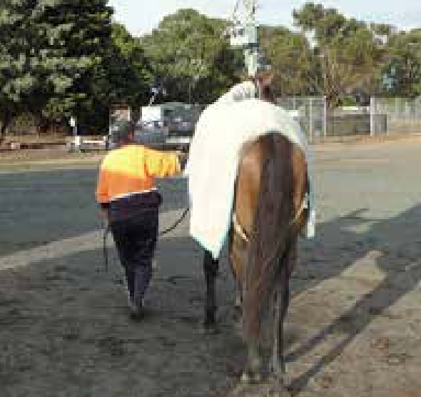
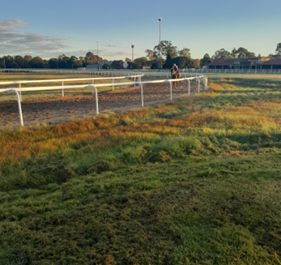
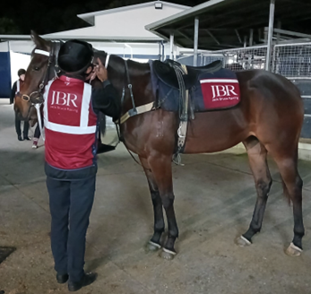
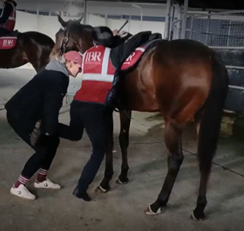
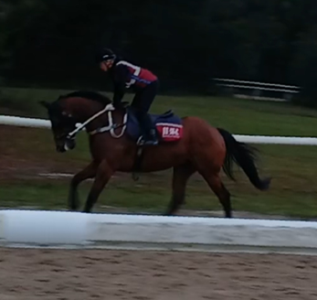
Leading Horse
Trackwork Example
Saddling Process
Mounting ‘legged up’
Riding Position

